Slide 1
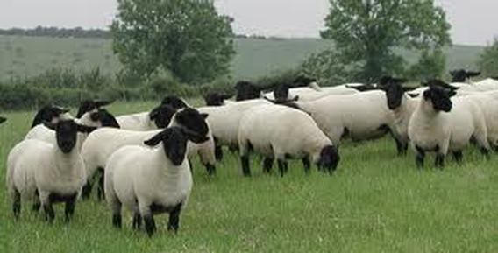
Selectively Breeding Sheep
N
n
N
NN
Nn
n
Nn
nn

Slide 2
Tongue Rolling Activity
With a partner sitting next to you, determine if you possess this talent!
How many students in our class can and can’t roll their tongue?
70% of people in the world can roll their tongue
Why are some people able to roll their tongue while others can’t?
Notes:
Begin lesson by asking students if they are able to roll their tongue. Let them pair up with a partner to decide if they are able to roll their tongues. Record how many kids in the class can and can’t roll their tongues. Record these numbers on the board. 70% of people in the world can roll their tongue.
Ask students why some people are able to roll their tongue while others aren’t.
Students might mention genetics, parent’s ability to roll tongue, practice, etc.
Tell students that genetics plays a role. And we have learned recently that environment may also be important. Students may be able to train themselves to roll their tongue. Over a decade ago, scientists believed this trait was controlled by a single gene. We now know it’s more complicated than that.

Slide 3
Using Punnett Squares
Father’s Alleles
N
N
Possible Offspring’s Alleles
Mother’s Alleles
N
NN
NN
Genotype
Probability
Homozygous NN 50%
Heterozygous Nn 50%
n
Nn
Nn
Notes:
Punnett Squares are simple tables used by geneticists to determine the outcome of various combinations of alleles. The father’s alleles are on top, and the mother’s alleles are on the side. The boxes contain possible allele combinations for the offspring. As you can see, all of the offspring would possess the dominant allele.

Slide 4
Using Punnett Squares
Father’s Alleles
N
N
Possible Offspring’s Alleles
Mother’s Alleles
N
NN
NN
Genotype
Probability
Homozygous NN 50%
Heterozygous Nn 50%
n
Nn
Nn
Phenotype
Probability
N 100%
*all offspring would show the dominant phenotype because all possible combinations contain a dominant allele (N)
Notes:
Punnett Squares are simple tables used by geneticists to determine the outcome of various combinations of alleles. The father’s alleles are on top, and the mother’s alleles are on the side. The boxes contain possible allele combinations for the offspring. As you can see, all of the offspring would possess the dominant allele. Repeat Punnett squares as necessary until students understand the concept

Slide 5
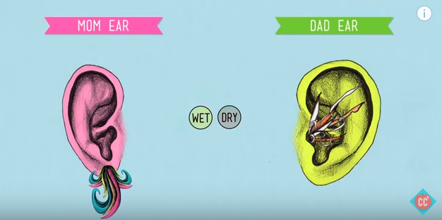
Mendelian Traits
Traits that are controlled by a single gene
Tongue rolling is NOT a true Mendelian trait
Once thought that widows peak, connected ear lobes, etc. were true Mendelian traits
Ear wax is controlled by a single gene (wet vs. dry)
https://www.youtube.com/watch?v=CBezq1fFUEA
Notes:
Mendelian traits are controlled by a single gene. Tongue rolling is not classified as a true Mendelian trait anymore. However, ear wax is controlled by a single gene. The YouTube video explains how ear wax is a true Mendelian trait.

Slide 6
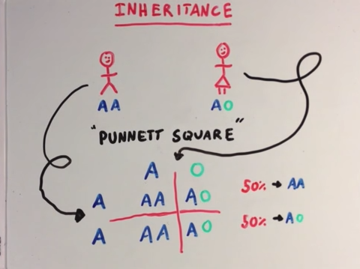
Genetics Review
https://www.youtube.com/watch?v=NR3779ef9yQ
Notes:
Another example of a Mendelian trait is blood type. If your students are not familiar with genetics vocabulary, have them watch this YouTube video for a quick review of genetics vocabulary. If your students are familiar with genetics, continue on with lesson.

Slide 7
Vocabulary Review
Gene: a section of DNA that codes for a certain trait
Allele: a variant of a gene
Dominant allele: written as an uppercase letter; 1 copy of this allele must be present to produce the dominant phenotype
Recessive allele: written as a lowercase letter; 2 copies of this allele must be present to produce the recessive phenotype
Genotype: genetic information responsible for an observable trait
Phenotype: observable characteristic
Homozygous genotype: gene with two of the same alleles (NN or nn)
Heterozygous genotype: gene with two different alleles (Nn)
Notes:
Let’s review some basic genetics vocabulary. Being familiar with these terms is important to continue on with the rest of the lesson.

Slide 8
Discussion Questions
How do the parents’ genes affect offspring?
Why is it important to predict the probability of a particular genotype being passed onto future offspring?
Notes:
How do the parents’ genes impact or affect possible offspring?
Offspring will inherit traits from their parents and be similar to their parents.
Why is it important to predict the phenotype of future offspring?
If a parent possesses an undesirable characteristic, you can see what the chances are that the offspring will also possess this undesirable characteristic.

Slide 9
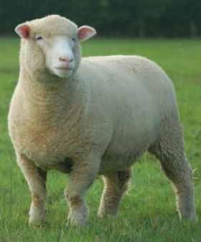
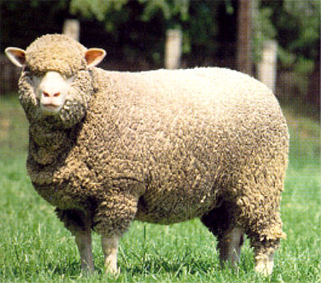
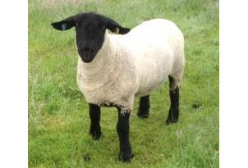
Sheep Information
Ruminant animals raised for meat and wool
5.28 million sheep in the United States
Over 200 different breeds of sheep exist today!
This diversity is the result of natural selection and selective breeding
Suffolk
Merino
Dorset
Notes:
Sheep are a common livestock animal raised in the United States. We are going to use sheep to apply genetics information. Here’s some basic information about sheep.
Look at the three photos of sheep on the screen. What are some of the differences you see in them? Which ones might be better at producing wool? Meat?

Slide 10
Activity #2: What is Natural Selection vs. Selective Breeding
Natural Selection
Organisms compete for limited resources
Animals/plants best suited to survive and reproduce in a particular environment pass on their traits to offspring
Animals/plants have free choice in who to breed/reproduce with
Selective Breeding
Also called artificial selection or unnatural selection
Process by which humans breed plants and animals for particular traits
For more information on natural vs. selective breeding, watch this video: http://learn.genetics.utah.edu/content/selection/artificial/
Notes:
Explain difference between natural and selective breeding. The genetics video from Utah is a great way to show students how these processes take place.

Slide 11
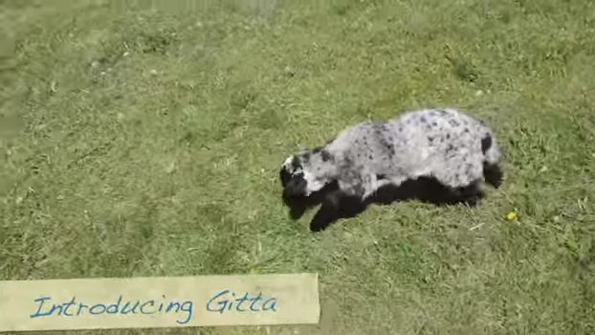
Watch Video
https://www.youtube.com/watch?v=b8tkOPAY56g
Notes:
Watch the YouTube video about Gitta. The video is less than 3 minutes. Instruct students to focus on the lamb’s ability to move and the physical characteristics instead of subtitles. Sheep breeders use selective breeding to get desirable traits, but somethings intended traits appear. Why might this be?

Slide 12
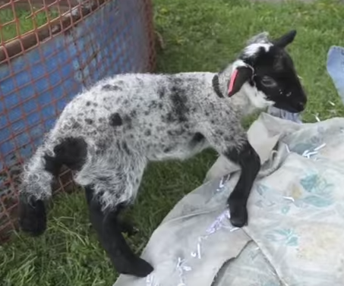
Discussion Questions
What did you notice about Gitta?
How does this impact the lamb?
How does this impact the sheep
breeder?
Notes:
After watching the video, ask students the following questions:
What did you notice about Gitta?
Gitta has troubles moving. She doses not walk normally . Her legs are long and bent.
How does this impact the lamb?
Gitta struggles getting around. She does not move like a normal lamb. It’s difficult for her to do basic activities.
How does this impact the sheep breeder?
Gitta may not live as long as the average sheep. She will not be able to be used for breeding.

Slide 13
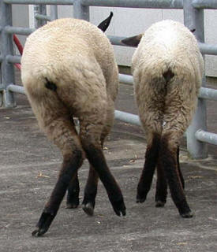
Spider Leg Syndrome (SLS)
Disorder related to abnormal transformation of cartilage to bone
Genetic disease inherited through a single recessive allele
Remember: A recessive trait needs two copies of the recessive allele to be observable!
Originated from gene mutation in the Suffolk breed
Symptoms:
Abnormally long or bent limbs
Twisted spines
Shallow bodies
Long necks
Notes:
Gitta has a syndrome known as spider leg syndrome. Let’s take a quick look at spider leg syndrome. Since it is a genetic disease, farmers can use Punnett squares to determine the likelihood of the offspring also having the disorder.

Slide 14
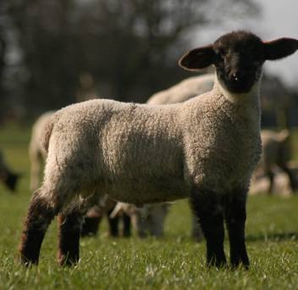
Keep in Mind!
Spider Leg Syndrome (SLS) is a recessive disorder
Possible combinations of alleles:
NN
Nn
nn
Healthy lamb
Healthy lamb, but a “carrier” of SLS gene
Lamb with SLS
Notes:
Remember that SLS is a recessive disorder. Offspring will either have the NN, Nn, or nn alleles.

Slide 15
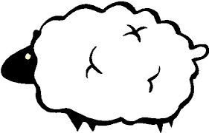
Sheep Terms
Ram: an uncastrated male sheep
Ewe: a female sheep
Lamb: a young sheep
Sire: father
Dam: mother
Notes:
Here is some basic sheep vocabulary. This will be important to know as we continue on with the rest of the lesson.

Slide 16
Activity #3 – You are a sheep farmer!
Question #1 - You mate two healthy sheep that are carriers for SLS, which means both the ram and the ewe have one dominant allele and one recessive allele. Fill out the Punnett Square.
N
n
N
n
Notes:
Turn to page #2 on your worksheet and complete question #1. Imagine you a sheep farmer. Complete the Punnett square.

Slide 17
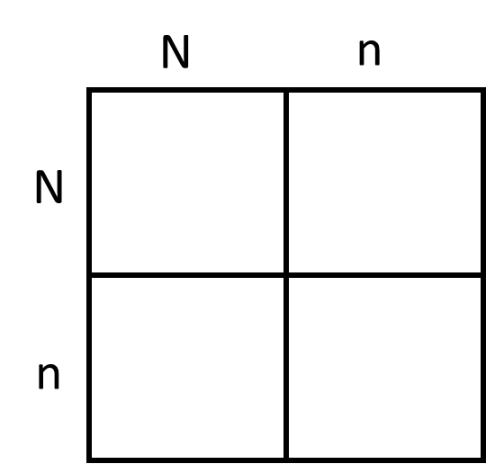
NN
Nn
Nn
nn
What is the probability that the offspring will have SLS?
What is the probability that the offspring will be carriers?
Do you think that breeders should mate two SLS carriers? Why or why not?
Notes:
Here is the completed Punnett square. Have students complete following questions.

Slide 18
Question #2 - You mate a sheep that does not carry a recessive spider allele with a carrier sheep. Fill out the Punnett Square.
N
N
N
n
Notes:
Question #2 is very similar to question #1. This time the ram is not a carrier. Complete the Punnett square.

Slide 19
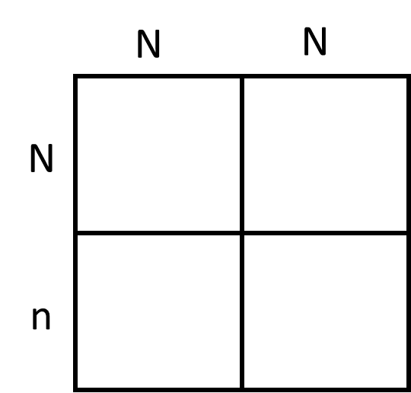
NN
NN
Nn
Nn
What is the probability that the offspring will have SLS?
What is the probability that the offspring will be carriers?
Do you think that breeders should mate a RR sheep with a carrier? Why or why not?
Notes:
Here is the completed Punnett square. Have students answer the following questions.

Slide 20
Question #3 - You buy a healthy ram from a neighboring farm, and you do not know his genotype. You mate him with a SLS carrier and the lamb is born with SLS. Fill in the Punnett Square with the genotype of the ram and his offspring.
____
____
N
n
Notes:
Question #3 requires some critical thinking. Carefully read the question and fill in the blanks.

Slide 21
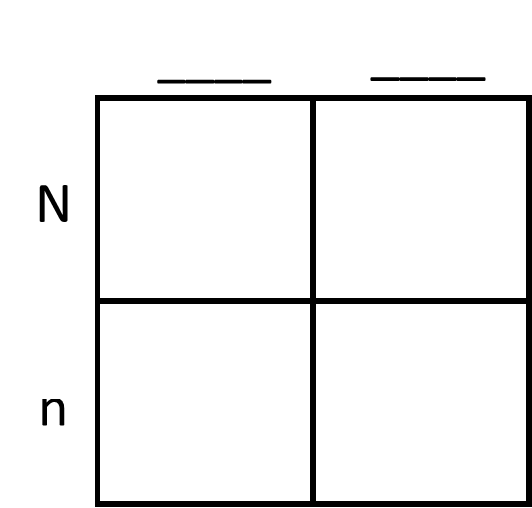
N
n
NN
Nn
Nn
nn
Notes:
Here is the ram’s genotype and the completed Punnett square.

Slide 22
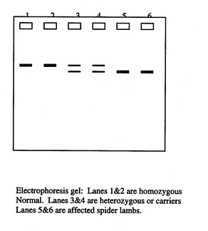
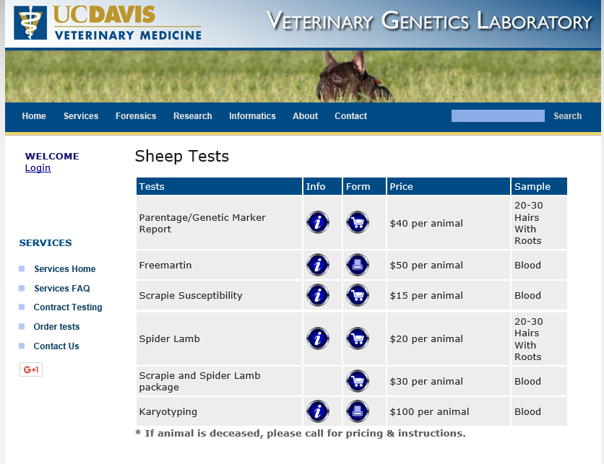
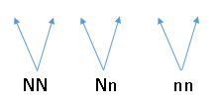
Electrophoresis Gel Test
Notes:
The picture on the left shows an electrophoresis gel test. The differences in the bands show if the sheep is healthy, a carrier, or affected by SLS. The photo on the right shows tests that UC Davis performs. As you can see, it costs a sheep breeder $20/animal to test it for SLS. Students should mention testing rams because they will pass their genes off to more offspring than a single ewe. This is a more cost effective strategy.

Slide 23
Cyber Sheep Online Game (Enriching Activity)
Student teams are the owners of their own virtual flock of sheep. Students will compete with other teams to make the most genetic gain in the flock and earn the most money. Students must use the knowledge they gained in this lesson to eliminate the SLS allele from the flock by purchasing DNA tests and completing Punnett Squares.
Interested teachers should contact Dr. Ron Lewis rlewis5@unl.edu for more information.
Notes:
If feasible, have students play the Cyber Sheep online interactive game!

