Slide 1
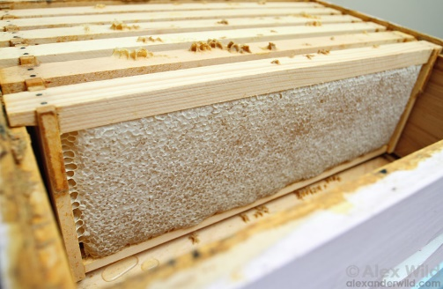
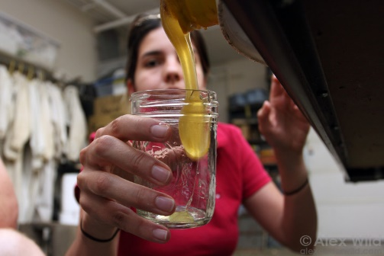
Fermentation of Honey
Notes:
On the left: image of honey that has been stored in the hive in a box called a honey super.
On the right: image of a beekeeper bottling freshly harvested honey
Images courtesy of Alexander Wild (www.alexanderwild.com)

Slide 2
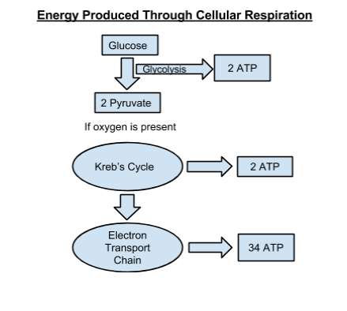
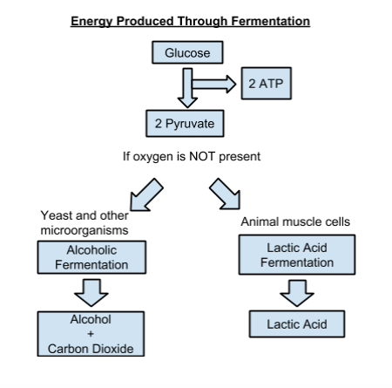
Aerobic Respiration
(with oxygen)
Anaerobic Respiration
(without oxygen)
Notes:
Review aerobic vs. anaerobic respiration
Discuss similarities and differences with students
Both produce energy in the form of ATP, both require glucose (and not other forms of sugar)
Aerobic respiration produces more energy (38 ATP) compared to anaerobic respiration (2 ATP)
Aerobic requires the presence of oxygen while anaerobic occurs in the absence of oxygen
Waste products are made in anaerobic respiration (alcohol, carbon dioxide, or lactic acid) but not in aerobic respiration

Slide 3
Lab Activity Materials
Sugar
Warm water
Weighing scales
Weighing boats or portion cups
Spoons
Bowls or beakers
Active dry yeast
50 mL beakers
Timer or clock
Respirometers
Syringe
Pipette
Plastic tubing
Student worksheet
Notes:
Discuss with students if they will need to mix up sugar solutions or if they will have access to pre-made solutions. Provide access to yeast suspension. Show students how to assemble the respirometer.

Slide 4
Lab Activity Procedures Making the yeast suspension
Make the yeast suspension up to 1 hour before lab
Use warm water!
Weigh out 80g of yeast per liter of water
Stir mixture in bowl or beaker
Notes:
To save class time, the yeast suspension can be made up to 1 hour in advance.

Slide 5
Lab Activity Procedures Making the sugar solutions
Using weight:volume ratio, determine amount of sugar and water to use
Weigh out sugar and add water to bring total up to 100mL
1g sugar = 1% sugar solution
5g sugar = 5% sugar solution
30g sugar = 30% sugar solution
50g sugar = 50% sugar solution
Mix together in bowls or beakers
Notes:
Sugar solutions may be measured and mixed in advance to save class time.

Slide 6
Lab Activity Procedures Assembling a respirometer
Droplet of water
Graduated pipette
Short length of plastic tubing
5cc syringe
Notes:
Students will need a graduated pipette, a short length of plastic tubing (1-2”), a 5cc syringe and a droplet of water.
When the students have allowed their yeast-sugar mixture to incubate for 5 minutes, they will draw 3mL of the mixture into the syringe. Draw an additional 1mL of air. Add a drop of water to the bottom of the graduated pipette and attach the pipette to the syringe with the plastic tubing. Stand the respirometer upright or vertically. Begin timing when the water droplet reaches the 0 on the graduated pipette.

Slide 7
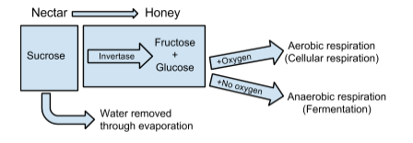
Honey as a Source of Energy
Notes:
Discuss as a whole class the process bees go through to ripen nectar into honey.
- Bees remove water by fanning their wings and add an enzyme known as invertase to break down sucrose into fructose and glucose. The glucose molecules are used to fuel aerobic or anaerobic respiration, creating energy for the bee.

Slide 8
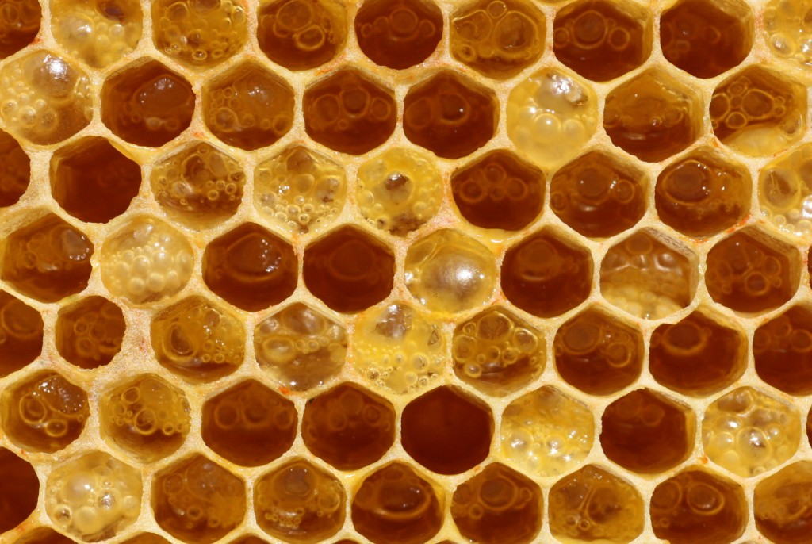
A Beekeeper’s Dilemma
What is happening to this honey?
Is it still good to eat?
Image source: http://www.honeybeesuite.com/uncapped-honey-fermenting-in-the-comb/
Notes:
Have students view this image of honey fermenting in honey comb.
Discuss what is happening to the honey.
- This is uncontrolled fermentation of honey by wild yeast.
Discuss if this honey would still be good to eat.
- This can result in an unpalatable food product for people, loss of market value for the beekeeper, and an unusable food source for bees.

