Slide 1
Backcross Breeding with Transgenic Plants

Slide 2
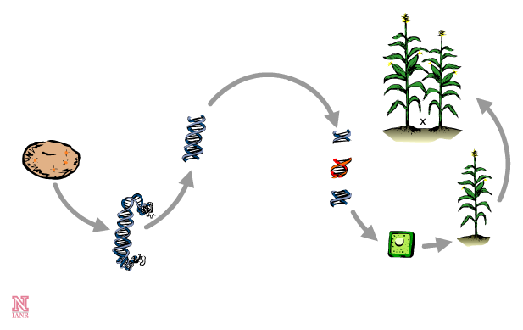
Steps in Crop Genetic Engineering
5. Backcross the transgenic (GMO) plant with an elite line to produce a hybrid
2. Locate, remove, and clone the gene
3. Modify the gene to express in a particular way
1. Extract DNA from organism with a desirable trait
4. Insert the gene into plant cells

Slide 3
Backcross Breeding
×
100% transgenic
100% elite

Slide 4
Backcross Breeding
×
100% transgenic
100% elite
F1 cross

Slide 5
Backcross Breeding
×
100% transgenic
100% elite
50% transgenic
50% elite
Each parent plant contributes 50% of their genes.
F1 cross

Slide 6
Backcross Breeding
×
100% transgenic
100% elite
50% transgenic
50% elite
Offspring:
F1 cross

Slide 7
Backcross Breeding
×
100% transgenic
100% elite
×
50% transgenic
50% elite
Offspring:
F1 cross
100% elite

Slide 8
Backcross Breeding
×
100% transgenic
100% elite
×
50% transgenic
50% elite
Offspring:
F1 cross
100% elite
Backcross 1

Slide 9
Backcross Breeding
×
100% transgenic
100% elite
×
50% transgenic
50% elite
Offspring:
F1 cross
100% elite
25% transgenic
25% elite
50% elite
Each parent plant contributes 50% of their genes.
Backcross 1

Slide 10
Backcross Breeding
×
100% transgenic
100% elite
×
50% transgenic
50% elite
Offspring:
F1 cross
100% elite
25% transgenic
75% elite
Offspring:
Backcross 1

Slide 11
Backcross Breeding
×
100% transgenic
100% elite
×
50% transgenic
50% elite
Offspring:
F1 cross
100% elite
25% transgenic
75% elite
×
Offspring:
Backcross 1
100% elite

Slide 12
Backcross Breeding
×
100% transgenic
100% elite
×
50% transgenic
50% elite
Offspring:
F1 cross
100% elite
25% transgenic
75% elite
×
Offspring:
Backcross 1
100% elite
Backcross 2

Slide 13
Backcross Breeding
×
100% transgenic
100% elite
×
50% transgenic
50% elite
Offspring:
F1 cross
100% elite
25% transgenic
75% elite
×
Offspring:
Backcross 1
100% elite
Each parent plant contributes 50% of their genes.
12.5% transgenic
37.5% elite
50% elite
Backcross 2

Slide 14
Backcross Breeding
×
100% transgenic
100% elite
×
50% transgenic
50% elite
Offspring:
F1 cross
100% elite
25% transgenic
75% elite
×
Offspring:
Backcross 1
100% elite
12.5% transgenic
87.5% elite
Offspring:
Backcross 2

Slide 15
Backcross Breeding
×
100% transgenic
100% elite
×
50% transgenic
50% elite
Offspring:
F1 cross
100% elite
25% transgenic
75% elite
×
Offspring:
Backcross 1
100% elite
12.5% transgenic
87.5% elite
×
Offspring:
Backcross 2
100% elite

Slide 16
Backcross Breeding
Four crosses have been performed in this example.
Backcrossing would continue until the offspring has >98% elite genes and the transgene.
×
100% transgenic
100% elite
×
50% transgenic
50% elite
Offspring:
F1 cross
100% elite
25% transgenic
75% elite
×
Offspring:
Backcross 1
100% elite
12.5% transgenic
87.5% elite
×
Offspring:
Backcross 2
100% elite

Slide 17
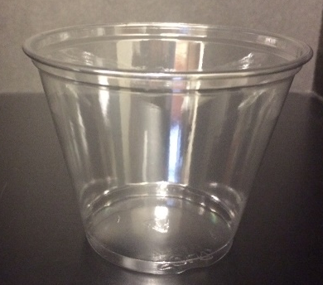
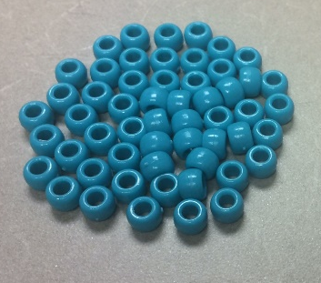

Backcross Breeding Simulation
Now it’s your turn….
  Break into groups of 2-3 students
  To get started, you will need:
    Three plastic cups
    Equal amounts of two different colors of beads

Slide 18
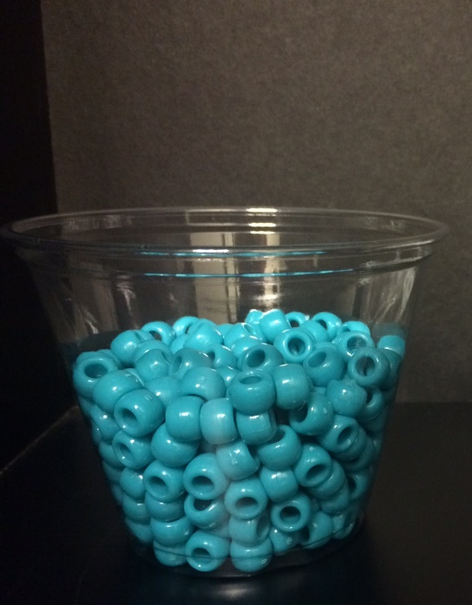

Making the first cross
Begin by filling two cups about half full with one color of beads in each.
100%
transgenic genes
100%
elite genes

Slide 19
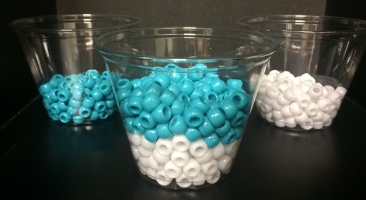
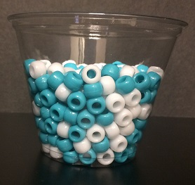
Making the first cross
2. Pour half of the beads from each cup into the empty cup and mix the beads.
Transgenic
Elite
F1 cross
What percentage of the genes…
  Are transgenic?
  Are elite?

Slide 20




Prepping for the next cross
After each cross, empty the unused beads from the parent transgenic cup. This will be your new empty cup.
Next, refill the 100% elite cup to full with beads. This will be used in the next cross.
Transgenic
Elite

Slide 21
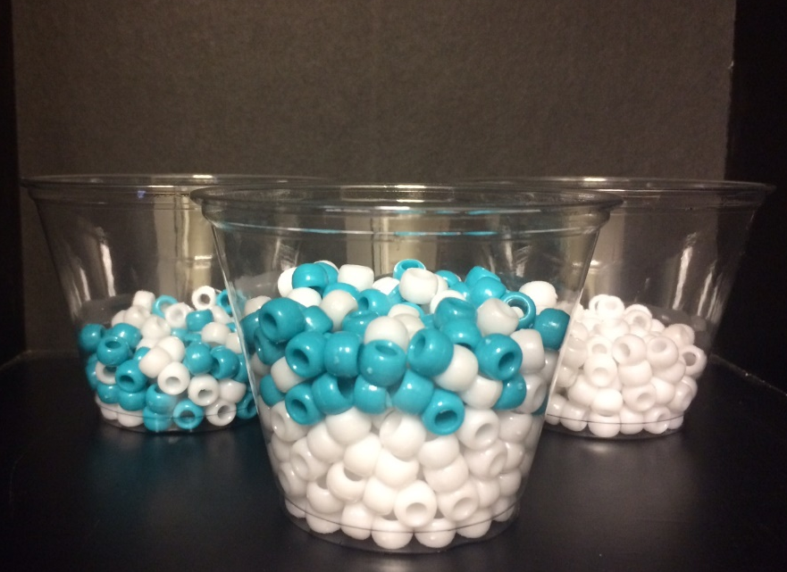
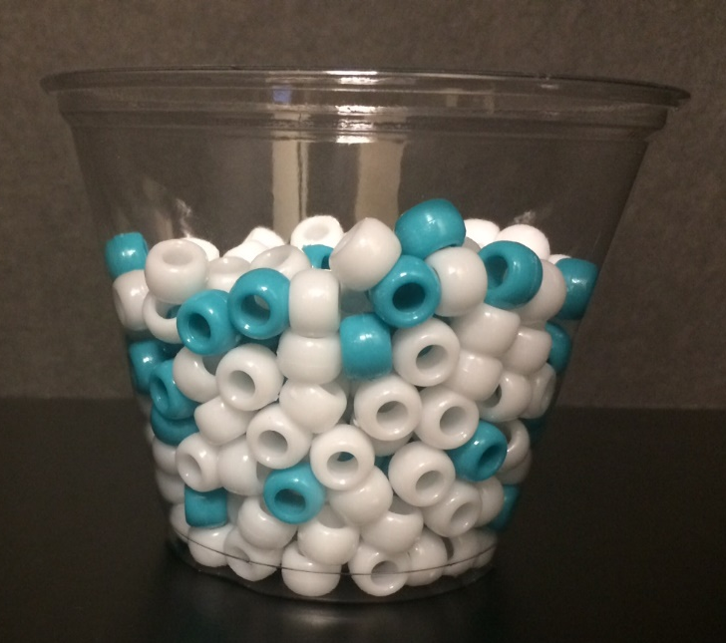
Making the first backcross
3. Pour half the beads from the F1 cross and 100% elite into an empty cup and mix the beads.
F1 cross
Elite
Backcross 1
What percentage of the genes…
  Are transgenic?
  Are elite?

Slide 22
Prepping for the next cross
After each cross, empty the unused beads from the parent transgenic cup. This will be your new empty cup.
Next, refill the 100% elite cup to full with beads. This will be used in the next cross.
F1 cross
Elite

Slide 23
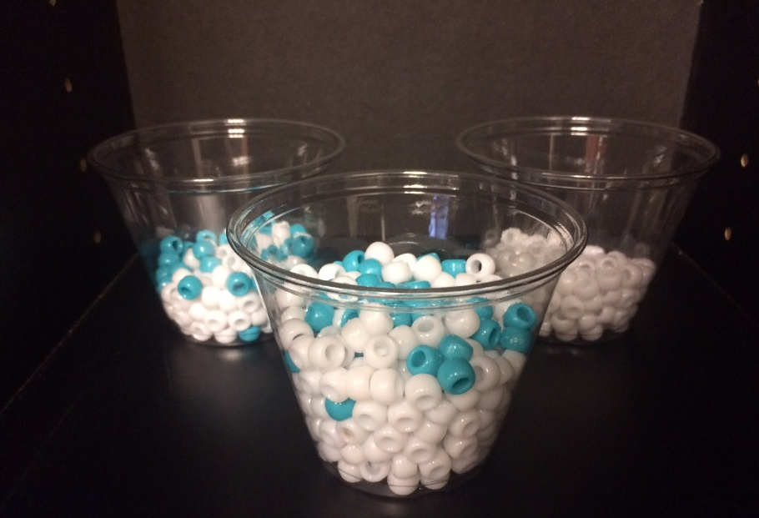
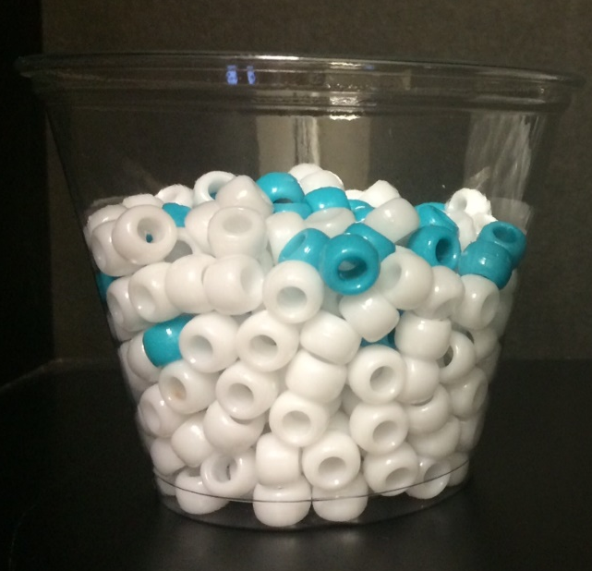
Making the remaining backcrosses
4. Continue this backcross process, mixing ½ the beads from the resulting “offspring” with ½ the beads from the 100% elite cup until the offspring genetics are >98% elite.
Backcross 1
Elite
Backcross 2
What percentage of the genes…
  Are transgenic?
  Are elite?

Slide 24
After 6 crosses, what percentage of the offspring’s genes…
  Are transgenic?
  Are elite?
  Fill in the student worksheet with the correct percentages.

Slide 25
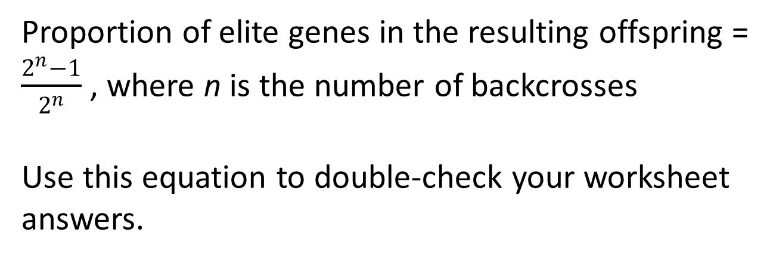
Calculating the percentage of elite genes
Proportion of elite genes in the resulting offspring = $\frac{2^{n}−1}{2^{n}}$ , where n is the number of backcrosses
Use this equation to double-check your worksheet answers.

Slide 26
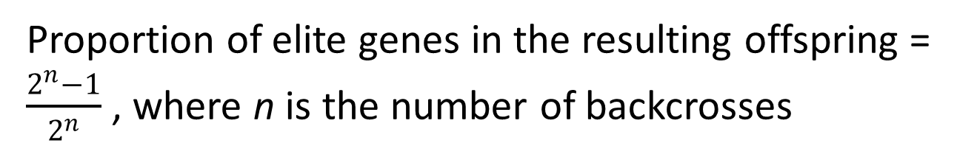
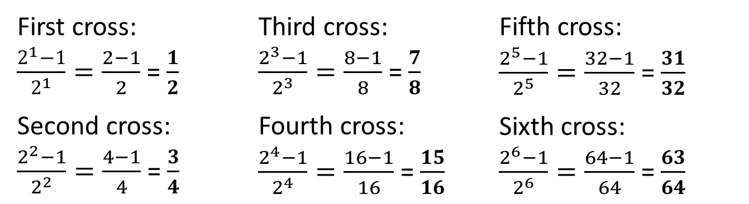
Calculating the percentage of elite genes
Proportion of elite genes in the resulting offspring = $\frac{2^{n}−1}{2^{n}}$ , where n is the number of backcrosses
First cross:
$\frac{2^{1}−1}{2^{1}}=\frac{2−1}{2}$ = $\frac{1}{2}$
Second cross:
$\frac{2^{2}−1}{2^{2}}=\frac{4−1}{4}$ = $\frac{3}{4}$
Third cross:
$\frac{2^{3}−1}{2^{3}}=\frac{8−1}{8}$ = $\frac{7}{8}$
Fourth cross:
$\frac{2^{4}−1}{2^{4}}=\frac{16−1}{16}$ = $\frac{15}{16}$
Fifth cross:
$\frac{2^{5}−1}{2^{5}}=\frac{32−1}{32}$ = $\frac{31}{32}$
Sixth cross:
$\frac{2^{6}−1}{2^{6}}=\frac{64−1}{64}$ = $\frac{63}{64}$

