Slide 1
Flower Anatomy and
Plant Breeding

Slide 2
Time Lapse of Flowers Blossoming
Watch the video: https://vimeo.com/69225705
What did you observe?
Did you notice any similarities or differences between the different types of flowers?

Slide 3
Activity 1: Structure and Function of a Flower
Materials needed:
One flower blossom
Microscope or hand lens (5x–10x)
Dissecting tools (probes, tweezers, scalpel)
Double-sided tape
Piece of paper

Slide 4
Activity 1: Structure and Function of a Flower
Procedures:
Draw a sketch of the flower.
Gather dissection materials.
Begin carefully dissecting the flower.
Gently remove parts of the flower, group them with similar parts.
Use double-sided tape to attach the parts to a piece of paper.
Write your prediction of what function each part serves in the plant next to each part group.

Slide 5
Functions of Flower Parts
Sepals: protects the flower
Petals: attracts a pollinator with color, scent, UV patterns
Stamen: contains male reproductive parts
Filament: supports the anther
Anther: produces pollen
Pollen: contains male genetic material, moves to fertilize the ovule
Pistil: contains female reproductive parts
Stigma: receives pollen
Style: connective tissue between stigma and the ovary
Ovary: contains the ovules
Ovules: contains female genetic material;
after fertilization, develop into seeds

Slide 6
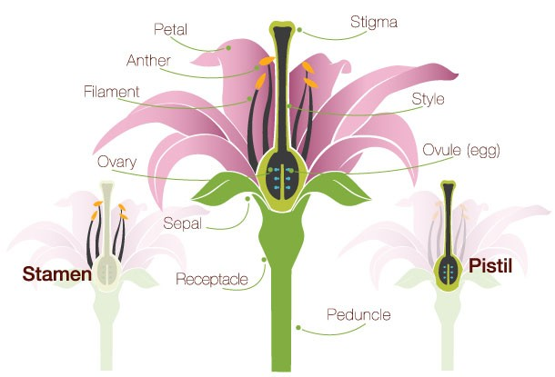
Anatomy of a Flower
Using this diagram as a guide, label your sketch with the correct terms.
Male
Female

Slide 7
Activity 1: Discussion
The parts of this flower make up what functional system for the plant?
What observations did you make about the flower petals? How do you think the petals contribute to plant reproduction?
What characteristics did you notice about pollen? Why do you think pollen is well-suited for moving genetic material between plants?
What did you observe about the stigma of the flower? How does this characteristic help the stigma to function?
Notes:
The parts of this flower make up what functional system for the plant?
The reproductive system
What observations did you make about the flower petals? How do you think the petals contribute to plant reproduction?
They may be colorful, smell good, have lines on them, etc. They attract insects looking for a food reward.
What characteristics did you notice about pollen? Why do you think pollen is well-suited for moving genetic material between plants?
Pollen is dusty, easily brushes off the anthers. It can easily be trapped in the hairs of pollinators when they are gathering pollen and nectar for food and then transferred when multiple flowers are visited.
What did you observe about the stigma of the flower? How does this characteristic help the stigma to function?
The stigma is sticky and is good for helping to adhere pollen to the plant.

Slide 8
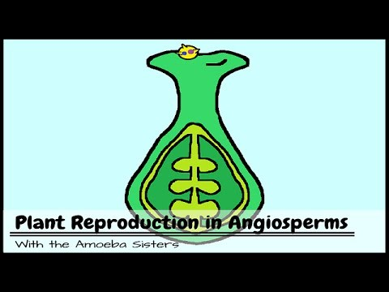
Activity 2: Plant vs. Human Reproduction
Watch the video.
Think about how plant and human reproduction are similar and different.
https://youtu.be/HLYPm2idSTE

Slide 9
Activity 2: Plant vs. Human Reproduction
Discuss the following:
According to the video, squash and green beans are considered fruit. Why is this?
Why are pollinators important for plant reproduction?
What is the purpose of fruit development in plant reproduction?
Notes:
According to the video, squash and green beans are considered fruit. Why is this?
All of these develop from the ovary of a fertilized flower so they are all considered fruit.
Why are pollinators important for plant reproduction?
Since plants don’t have the ability to move their own genetic material around, they rely on insects or wind to carry it around for them. Pollinators do this by accidently picking up pollen while feeding on nectar and pollen. Only after a plant is pollinated can the pollen fertilize the ovule in order to develop seeds.
What is the purpose of fruit development in plant reproduction?
Fruits help the seeds travel far from the parent plant. They can be carried by wind, water, or an animal, or eaten by an animal and deposited elsewhere.

Slide 10
Activity 3: Controlling Plant Reproduction in Agriculture
Watch the video “How to cross soybeans” found here: https://vimeo.com/82420755

Slide 11
Activity 3: Controlling Plant Reproduction in Agriculture
How big were the soybean flowers compared to the flower you dissected in activity 1?
What steps were taken to pollinate a soybean plant?
What is the benefit of a plant breeder pollinating soybeans by hand rather than relying on an insect pollinator to move the genetic material from one plant to another?
Why might a breeder want to control which parent plants are used in the reproduction of soybean seeds?
Notes:
What was one difference you noticed about the size of soybean flowers compared to the flower you dissected in activity 1?
Soybean flowers are much smaller than the flower that was dissected.
Explain, in detail, what a plant breeder must do to pollinate a soybean plant.
The breeder must know what crosses they want to make (which female and male parents they want to use).
Identify a female plant that has buds that will be opening soon.
Pull the sepals back to expose the petals.
Gently pull the petals out to expose the anthers and the stigma.
Clean (remove) the anthers out of the bud.
Find a male plant to pollinate the plant.
Collect the selected male parent flower to be used in the cross.
Open the flower to expose the anthers.
Pull out the anthers. Be sure that pollen is present.
Brush the pollen from the anthers onto the stigma.
What is the benefit of a plant breeder pollinating soybeans by hand rather than relying on an insect pollinator to move the genetic material from one plant to another?
If the plant breeder pollinates the soybean plant by hand, this guarantees that specific male genetics of one plant are combined with the female genetics of another plant. The breeder has more control over the cross than if insects randomly moved pollen from one plant to another.
Why might a breeder want to control which parent plants are used in the reproduction of soybean seeds?
This allows breeders to select for desirable traits and keep track of which parents produce offspring with these particular traits.

Slide 12
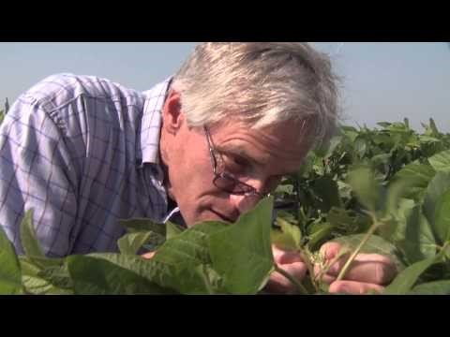
Activity 4: Careers in Plant Breeding

Slide 13
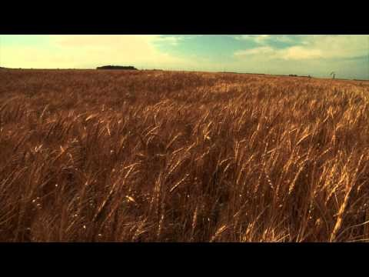
Activity 4: Careers in Plant Breeding

Slide 14
Activity 4: Careers in Plant Breeding
What skills do you have that could contribute to a career in plant breeding? What new skills would you need to learn in order to succeed as a plant breeder?
What would you like and dislike about being a plant breeder?
Who is Norman Borlaug and how did his work change agriculture around the world?
Notes:
Who is Norman Borlaug and how did his work change agriculture around the world?
Norman Borlaug was a plant breeder who helped farmers to improve their crops and increase their yields. In three years, he used plant breeding techniques to develop wheat that was resistant to stem rust fungus and crossed it with locally-adapted susceptible plants and select for resistant lines. His team accelerated the breeding process by evaluating and selecting resistant lines twice every year. This strategy was known as shuttle breeding. He grew the wheat in two locations with different day lengths, making the wheat adaptable to many different areas. His wheat also responded well to fertilizer and so developed heavy seed heads. The heavy seed heads collapsed under the weight causing a problem called lodging. He used plant breeding techniques to solve this problem. Breeders had developed a line called semi-dwarf wheat which grew shorter, stronger stalks which could support the weight of the grain. Borlaug crossed this line into his breeding program to produce a wheat line that would not lodge and was adapted to growing conditions in Mexico. His wheat lines were then grown in other areas such as India and Pakistan increasing wheat yields dramatically. This dramatic increase in food production was called the green revolution.
His efforts to improve agriculture were recognized when he was awarded a Nobel Peace Prize in 1970.

