Slide 1
Biological Control of
Invasive Species

Slide 2
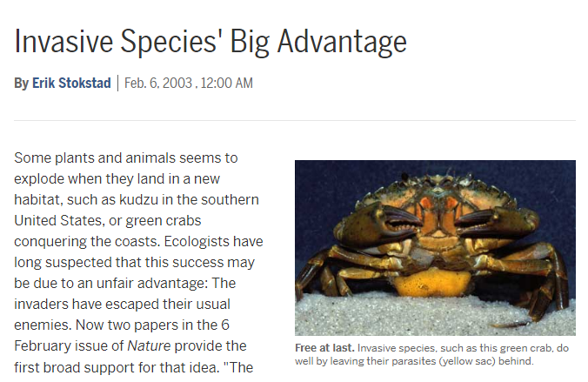
Success of Invasive Species
Read the article “Invasive Species’ Big Advantage” found here: http://www.sciencemag.org/news/2003/02/invasive-species-big-advantage

Slide 3
Discussion Questions
What major advantage do invasive species have over native organisms according to the article?
What evidence does the article provide to support this idea?
What is biological control?
What “collateral damage” do you think could be caused by improper use of biological control?

Slide 4
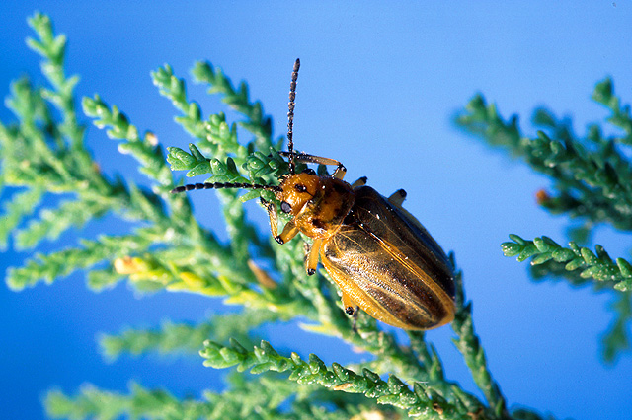
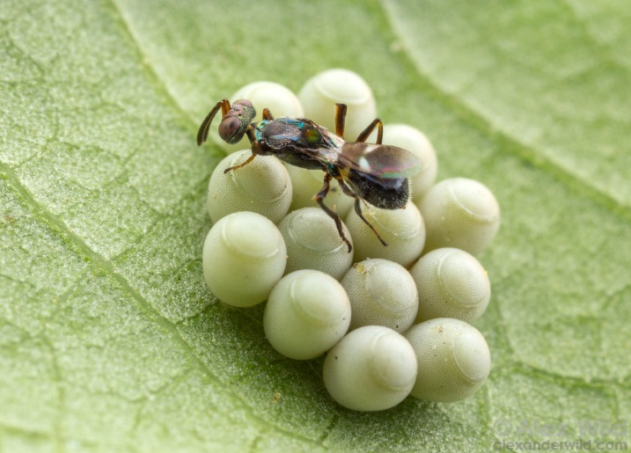
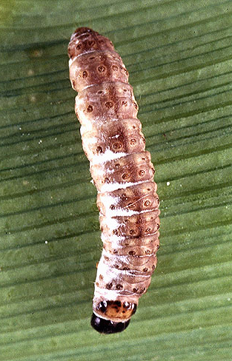
Biological control is…
A pest control method in which natural enemies (predators, parasites, or pathogens) are used to regulate pest populations
Predator/Herbivore
Parasite
Pathogen
Leaf beetle eating invasive plant, saltcedar Photo by Bob Richard, APHIS
Wasp laying eggs in stink bug eggs Photo by Alex Wild
Fungus infecting larvae
Photo by Keith Weller, USDA

Slide 5
Evaluating Biological Control Methods
Think-pair-share: Brainstorm 2 benefits and 2 risks
Possible benefits
Possible risks

Slide 6
Activity 2: Evaluation of Biological Control
Read the two articles
  Scenario #1: Weed-eating insects munch wrong plants http://www.sciencemag.org/news/2001/08/weed-eating-insects-munch-wrong-plants
  Scenario #2: A virus is taming Australia’s bunny menace, and giving endangered species new life http://www.sciencemag.org/news/2016/02/virus-taming-australia-s-bunny-menace-and-giving-endangered-species-new-life

Slide 7
Activity 2: Article Discussion
 | Scenario #1 | Scenario #2
Biological Control Agent?
Target Pest?
Evidence of Success?
Evidence of Unintended Consequences?

Slide 8
Making decisions about biological control
Based on the scenarios you read….
What do you consider a successful biological control release?
What should regulators consider before releasing a biological control agent?

Slide 9
What does the process of releasing a biological control for invasive weeds look like?
Read the article “How Scientists Obtain Approval to Release Organisms for Classical Biological Control of Invasive Weeds” by J. Scoles, J. P. Cuda and W. A. Overholt found at https://edis.ifas.ufl.edu/pdffiles/IN/IN60700.pdf
Answer the follow-up questions on your worksheet

Slide 10
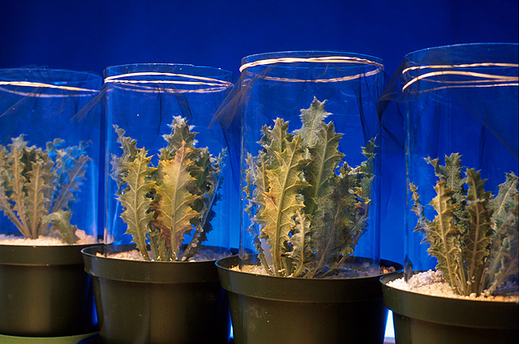
What does the process of releasing a biological control for invasive weeds look like?
Potential biological control agents are confined in small cages with a test plant (Scotch thistle, in this case) to confirm whether they will feed and reproduce on that plant.
Photo by Keith Weller, USDA

Slide 11
Implementation Discussion
Who is involved in approving the release of a new biological control agent?
What are their roles?
Why are the following scientific tests or assessments required before a biological control agent can be released?
  Host specificity testing
  Environmental assessment
  Biological assessment

Slide 12
Design a biological control for an invasive species
Choose an invasive species that impacts your area. If you have completed an invasive species profile, you may use that organism. Otherwise, perform an internet search.
Invent a biological control agent for your invasive species
  This is an imaginary species that doesn’t exist-feel free to pull ideas from existing species though
  Can be a parasite, disease/pathogen, or predator

Slide 13

Example
Answer the 3 Questions:
How does the biological control agent regulate the invasive species population?
It causes death in European rabbits by attacking their immune systems. Mothers pass the disease to young.
How will you determine if your biological control organism is successful?
More than 50% of the European rabbit population will be killed by the initial release of the virus. Eradication of all rabbits is likely not possible. Population will remain at this reduced level for 5 years.
What steps will be taken to ensure the biological control agent will not have unintended consequences?
Host specificity testing will be performed to ensure the virus only affects this rabbit species. An environmental assessment will be completed to determine how the ecosystem might be affected long-term.
Draw picture of your biological control agent
European Rabbit Virus

