Slide 1
Controlling Invasive Species

Slide 2
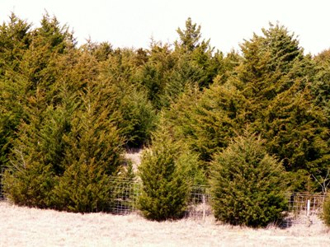
What’s at your desk?
As you enter class, you might be surprised to see what is on your chair.
Before you can move it, you must choose a control method and place it next to the branch on your chair.
www.forestry.ok.gov/ercregistry

Slide 3
Making an informed control decision…
Which control measure did you select and why?
What factors are important when selecting a control measure?
What long-term impacts can a control measure have on a population?

Slide 4
Why are Eastern Red Cedar populations growing?
Native to central plains
They have many adaptive traits
Grow in many soil types
Drought tolerant
Birds spread seeds
Digestion actually improves germination
They are invading areas
Lack of fire to control their spread
www.forestry.ok.gov/ercregistry

Slide 5
Why do Eastern Red Cedar trees need to be controlled?
Read the fact sheet: http://www.digitalprairie.ok.gov/cdm/ref/collection/stgovpub/id/40058
What are some of the problems caused by the growing population of Eastern Red Cedar trees?
What control methods are recommended?
Was your selected control method a good choice? Why or why not?

Slide 6
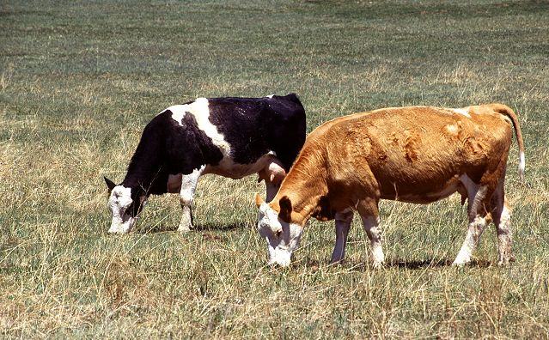
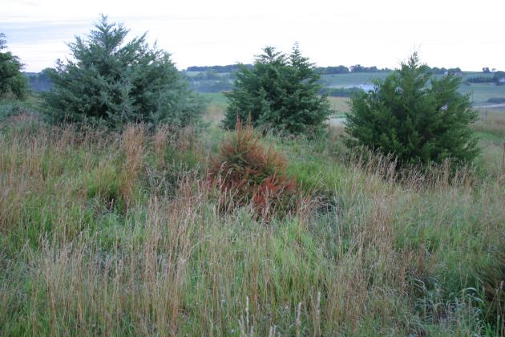
Eastern Red Cedar Infestations
Cattle require pastures dominated by non-woody vegetation
E. red cedar infestations reduce the amount of food available for cattle to graze
E. red cedar infestations affect cattle production by reducing the number of acres available to graze cattle
Pasture providing grazing food for cattle
E. red cedar infestation reducing cattle forage resources
Notes:
Two cows grazing, Scott Bauer, USDA, public domain
Find image web address for cedar infestation

Slide 7
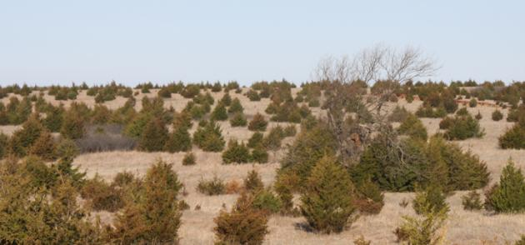
Adult Tree Infestations
Older trees are more difficult to control
Prescribed burning coupled with mechanical removal are control options
Proactive control is best
Control small infestations to keep them manageable and preserve existing farming land and wildlife habitat
Notes:
Find image web address for cedar infestation

Slide 8
Mechanical Removal Control Option
Note areas where control occurred
http://www.fws.gov/southwest/es/oklahoma/Images/Cedar_Clearing.jpg

Slide 9
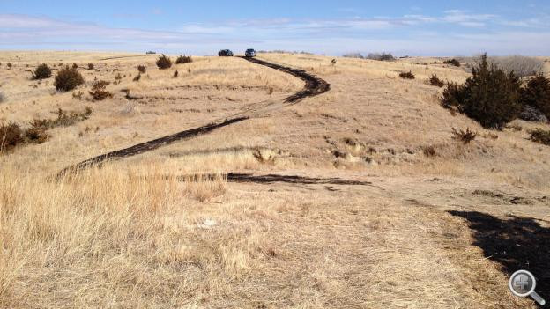
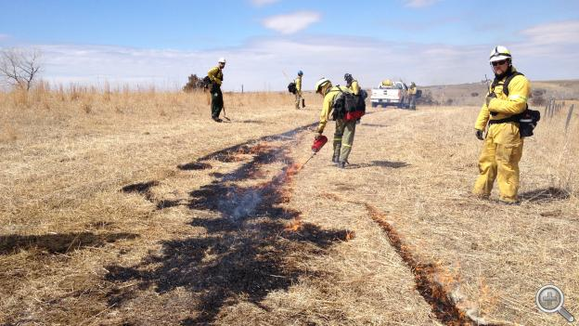
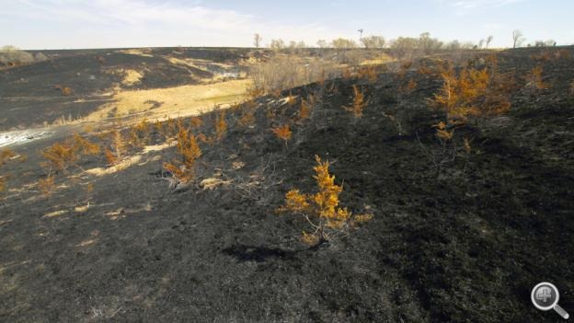
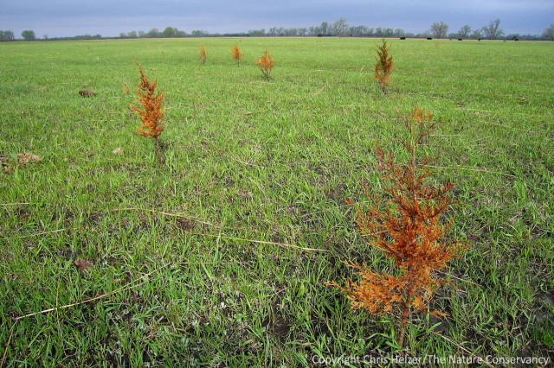
Prescribed Fire Management
2 months after burn
http://netnebraska.org/article/news/911117/firefighters-make-fire-work-them-prescribed-burn http://prairieecologist.com/2013/03/12/should-we-be-conducting-prescribed-fires-during-drought/

Slide 10
Now it’s your turn…
Calculate the economic impact of an Eastern Red Cedar infestation.
Calculate the cost of various control options.
Determine the best course of action.

Slide 11
Calculating the cost of the infestation
You recently inherited 160 acres of pastureland from your great aunt’s estate. You want to rent out the land to a cattle producer for grazing purposes, however, the pasture is infested with cedar trees. Currently, the land can only support grazing for 21 cow-calf pairs in the pasture during a season. However, most other pastures in the area can graze 32 pairs per 160 acres.
In 2015, the average rent per cow-calf pair in the area was $450 per year.
How much money would the cedar tree infestation cost you per year?
Notes:
32 pairs - 21 pairs = 11 pairs * $450 = $4950.00

Slide 12
Calculating the cost of control
You were quoted a cost of $105 per acre to clear trees off your pasture mechanically with a skid loader and grinder.
A prescribed burn will cost $15 per acre, but you would have to not graze the pasture for one year before the burn.
Compare the costs of these two control measures. Which control measure is more economical?
Notes:
160*$105 = $16,800
160*$15 = $2400 + 21*$450 = $11,850

Slide 13
Selecting a control measure
Which control measure did you select? Why?
Other than financial reasons, can you think of any reasons to select one control method over another?

Slide 14
Potential issues with control
Imagine after a prescribed burn, there were several large Eastern Red Cedar trees that didn’t die.
How could this lead to genetic change in the population of Eastern Red Cedar trees in your pasture?
prairieecologist.com/2013/03/12/should-we-be-conducting-prescribed-fires-during-drought/
Notes:
What is the selection pressure?
What is the trait being selected for?

Slide 15
Evolution of resistant populations
Using the Eastern Red Cedar example, draw a diagram to illustrate how genetic variation, selection pressure, and an adaptive trait relate to evolution within a population.
What strategies might you use to avoid selecting for individuals resistant to a particular control method?

Slide 16
New ways of delivering a prescribed burn
Watch the video: https://www.youtube.com/watch?v=GYJF-k8enz0
What are some benefits of this new technique for performing a prescribed burn?

