Slide 1
Adaptive Traits and Invasive Species

Slide 2
Do all introduced organisms become invasive?
Play the Space Invaders Game
Object of the game:
Survive in the plant ecosystem after 5 rounds of play.
Materials you will need:
Three game boards (normal, dry, wet year)
Three plant type cards (native, introduced, invasive)
Game pieces (three different kinds, ~24 pieces each player)
Scorecard
Pen or pencil
Notes:
Make images of game boards, game pieces, plant type cards

Slide 3
How to play

Slide 4
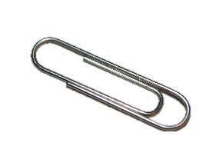
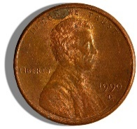
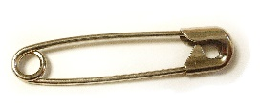
To get started…
1. Three players per game
2. Choose a game board (wet, dry, or normal)
3. Each player randomly selects a plant type card
4. Each player chooses game pieces (need 24 alike pieces)
Notes:
Provide simple instructions

Slide 5
Instructions
Play will start with the player whose birthday is closest to Earth Day (April 22) and continue in clockwise direction.
Follow the rules on your plant type card!
Each game piece = one plant.
Place the number of plants indicated by “Establishment” on your card on the game board.
Gather new plants according to the rules for “Reproduction” on your card.
Place new plants on your next turn.
Notes:
Provide simple instructions

Slide 6
Normal Year
Only a single plant type can be placed on a space.
Adjacent spaces
Each space can hold 2 plants.
When two plants of the same type are placed on a space, they reproduce.
Dry | Moist | Wet
Habitat Spaces Key:

Slide 7
Do all introduced organisms become invasive?
Two non-native species were in the game.
Were they both successful?
Why do you think this was?
How did the invasive plant species outcompete the other plants?
How might climate change impact the reproductive success of the different plant types?
Notes:
Needs images to illustrate lots of seeds, easy dispersal, climate tolerance

Slide 8
Do all introduced organisms become invasive?
No. In general, about 1 of every 1000 non-native plants actually becomes an invasive pest (but there are exceptions!)
The “ten-ten-ten rule”
One of every ten imported plants appears in the wild
One of those ten introduced plants becomes established in an ecosystem
One of those ten established plants actually becomes a pest
From Allyson Muth, Forest Stewardship Program Associate, Penn State Department of Ecosystem Science and Management

Slide 9
Why are invasive species so successful?
We don’t fully know the answer.
Possibilities
Having adaptive traits
Lack of selection pressure
Something else?
Tolerant to wide range of conditions?
Produces lots of seeds or eggs?
Disperses itself with ease?
Reproduces quickly?
No natural enemies in new habitat?
Escape from former specialist enemies?
Not susceptible to diseases in the new habitat?

Slide 10
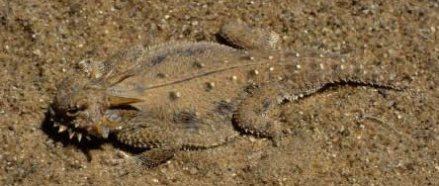
A trait is adaptive if….
It is heritable
(Thanks, Mom and Dad for the great genes!)
It is functional
(Predators don’t eat me if they can’t see me!)
It arises due to selection pressure
(Those of us that aren’t camouflaged are eaten!)
It increases fitness
(When I don’t get eaten, I have a much better chance of reproducing and passing on my genes!)
Flat-tail horned lizard: Public Domain, https://commons.wikimedia.org/w/index.php?curid=473183

Slide 11
Are all traits adaptive?
Not all traits are adaptive!
Non-adaptive trait: Doesn’t provide any survival or reproductive advantage
Maladaptive trait: If environment changes, a trait may no longer be adaptive and may actually reduce fitness
Can you think of any non-adaptive or maladaptive traits?

Slide 12
Selection Pressure
Selection pressure occurs when any biotic (living) or abiotic (non-living) factor impacts the reproductive success of some individuals in a population more than others
Examples include predation, parasitism, weather or climate, exposure to pesticides, etc.
How might selection pressure and adaptive traits be related?
Notes:
Ways environments or conditions change?
A disease is introduced
Weather and climate (dry, wet, hot, cold, etc.)

Slide 13
Defining Three Types of Adaptive Traits
Morphological adaptations
Change occurs to the form or structure of the organism
Physiological adaptations
Change occurs to the function or response of the organism
Behavioral adaptations
Change occurs to the behavior of the organism

Slide 14
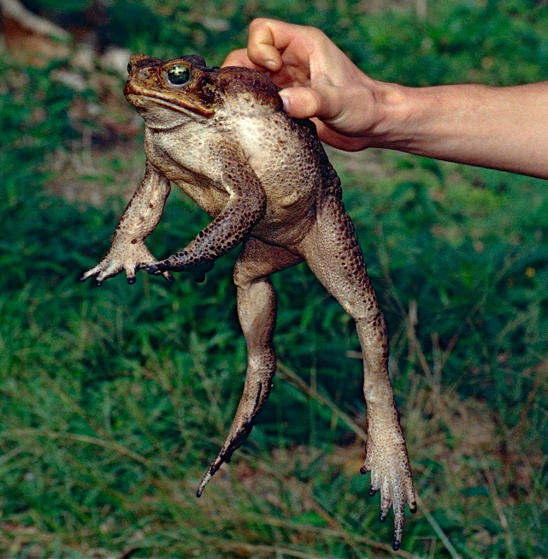
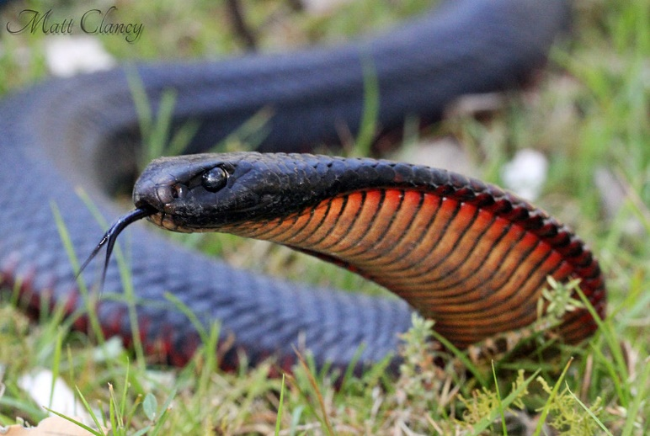
Invasive species can act as selection pressure!
Cane toads were introduced into Australia in 1935.
No toxic toads were present in Australia prior to the introduction.
Arrival of this novel and highly toxic prey item acted as a selection pressure on a native predator, the Australian black snake.
Invasive prey, cane toad
Photo: Bernard DUPONT from FRANCE via Wikimedia Commons
Native predator, black snake
Photo: Matt Clancy via Wikimedia Commons

Slide 15
Morphological Adaptations
Cane toad arrival selected for snakes with bigger bodies and smaller heads.
Probability of eating a toad large enough to be fatal decreases with an increase in snake body size.
Photo: Matt Clancy via Wikimedia Commons
Source: Adapting to an invasive species: Toxic cane toads induce morphological change in Australian snakes by Ben Phillips and Richard Shine, DOI: 10.1073/pnas.0406440101
Notes:
In Australia, invasive cane toads (Bufo marinus) are highly toxic to most snakes that attempt to eat them. Because snakes are gape-limited predators with strong negative allometry for head size, maximum relative prey mass (and thus, the probability of eating a toad large enough to be fatal) decreases with an increase in snake body size. Thus, the arrival of toads should exert selection on snake morphology, favoring an increase in mean body size and a decrease in relative head size. We tested these predictions with data from specimens of four species of Australian snakes, collected over >80 years. Geographic information system layers provided data on the duration of toad exposure for each snake population, as well as environmental variables (latitude, precipitation, and temperature). As predicted, two toad-vulnerable species (Pseudechis porphyriacus and Dendrelaphis punctulatus) showed a steady reduction in gape size and a steady increase in body length with time since exposure to toads.
Cane toad image by Bernard DUPONT from FRANCE (Cane Toad (Rhinella marina) adult female) [CC BY-SA 2.0 (http://creativecommons.org/licenses/by-sa/2.0)], via Wikimedia Commons

Slide 16
Physiological Adaptations
Populations of snakes previously exposed to cane toads showed an increased resistance to the toad toxin.
Snakes showed increasing resistance to toad toxin with increasing exposure time.
Photo: Matt Clancy via Wikimedia Commons
Source: An invasive species induces rapid adaptive change in a native predator: cane toads and black snakes in Australia by Ben Phillips and Richard Shine, DOI: 10.1098/rspb.2006.3479

Slide 17
Behavioral Adaptations
Populations of snakes exposed to cane toads for 40-60 years showed a preference for prey items other than cane toads.
Populations of snakes never exposed to cane toads would eat either prey item (frog or cane toad).
This was an innate behavioral response. This behavior could not be taught to snakes in a laboratory setting.
Photo: Matt Clancy via Wikimedia Commons
Source: An invasive species induces rapid adaptive change in a native predator: cane toads and black snakes in Australia by Ben Phillips and Richard Shine, DOI: 10.1098/rspb.2006.3479

Slide 18
Invasion of the Snakehead
What adaptations are mentioned?
Morphological
Physiological
Behavioral
Watch the video: https://youtu.be/nmU7etSYYqI

Slide 19
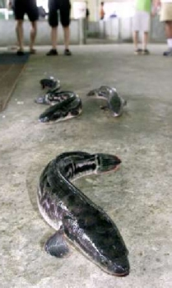
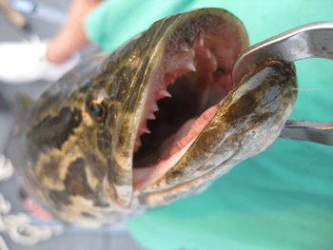
Review Snakehead Adaptations
Morphological adaptations:
Muscular bodies
Sharp teeth
Physiological adaptations:
Can breath oxygen from air using air bladder
Can live out of water for several days if they stay moist
High reproductive capacity
Behavioral adaptations:
Aggressive
Photo: REUTERS/Jonathan Searle
Photo: http://dnr2.maryland.gov/fisheries/PublishingImages/snakehead02.jpg

Slide 20
Now it’s your turn to build a Super Competitor…
Design and draw an invading organism capable of surviving and reproducing on an alien plant.
Describe your organism’s adaptive traits.
What advantages do these adaptations provide in their new ecosystem?

