Slide 1
Invasive Species 1:
What is an Invasive Species?

Slide 2
Can you name an invasive species in our area?

Slide 3
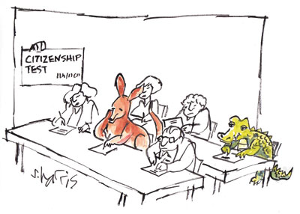
What is an invasive species?
An invasive species is an organism that…
  Is not native to an ecosystem (it may be native to the region)
  Is likely to cause economic or environmental harm or harm to human health
http://www.nature.com/nature/journal/v475/n7354/images/475036b-i1.0.jpg

Slide 4
Web Search for Invasive Species
Conduct a web search for invasive species in our state. What kinds of organisms are invasive?
On the board, write down an invasive species you found.
Which websites provided useful information?
Notes:
Federal, state, and local government share the responsibility for preventing, eradicating, and controlling invasive species. So as a tip, students can do a web search for “invasive species United States site:gov” to find information from only government websites.
For a list of federal agencies involved, laws regarding invasive species, and estimated invasive species numbers and associated costs can be found here: http://nationalaglawcenter.org/wp-content/uploads/assets/crs/R43258.pdf
Federal (Department of Interior)
U.S. Fish and Wildlife Service: https://www.fws.gov/invasives/index.html
For resources from state agencies: http://www.invasivespeciesinfo.gov/unitedstates/state.shtml
Center for Invasive Species and Ecosystem Health (images of invasives of economic importance for educational use): http://www.invasive.org/

Slide 5
Invasive Species Profile
Divide into teams of 2-3 students and select an invasive species from our list on the board.
Develop an invasive species profile using good sources of information. Must include:
  An image or drawing of the invasive species
  How it was introduced (and when, if possible)
  What species or resources it threatens
  A reason it is biologically successful (how does it outcompete other species?)
Notes:
For state specific resources: http://www.invasivespeciesinfo.gov/unitedstates/state.shtml
This is NOT a complete list of resources. Students will probably have better luck searching google for “invasive species” and the name of their state.

Slide 6

Invasive Species Profile
Example of Front Page:
Front of page
Draw the species & list the common name
Back of page
How they were introduced
Species or resources they threaten
Explain why they are biologically successful
European Rabbit
Example of Back Page:
Introduced in Victoria, Australia by a citizen.
Have decimated most of the local sheep’s and cattle's grass
Rapid population growth

Slide 7
What are common routes of introduction?
Notes:
Drawing from their profiles, have students add to this

Slide 8
How are humans involved in the introduction of invasive species?

Slide 9
What kind of problems are caused by invasive species?

Slide 10
Why are invasive species so successful?

Slide 11

Invasive Species Most Wanted
Most expensive to control?
Toughest to control?
Most damaging to an ecosystem?
Fastest invasion?
Sneakiest invasion?
Biggest up-and-coming invader?
https://pixabay.com/static/uploads/photo/2015/12/08/00/17/wanted-1081663_960_720.jpg

Slide 12
Limiting spread of invasive species
With your group, discuss solutions to limit the spread of your invasive species.
What are the benefits and limitations of your solution?
  Is it costly?
  Is it feasible?
  Is it labor intensive?

