Slide 1
Testing Transgenics: DNA Analysis and Protein Detection

Slide 2
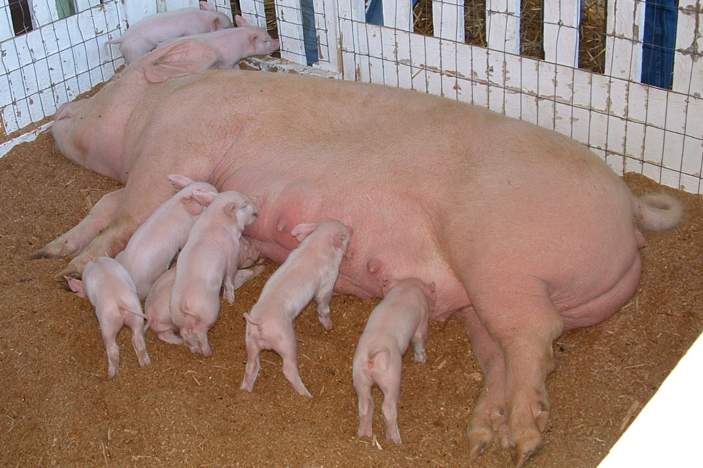
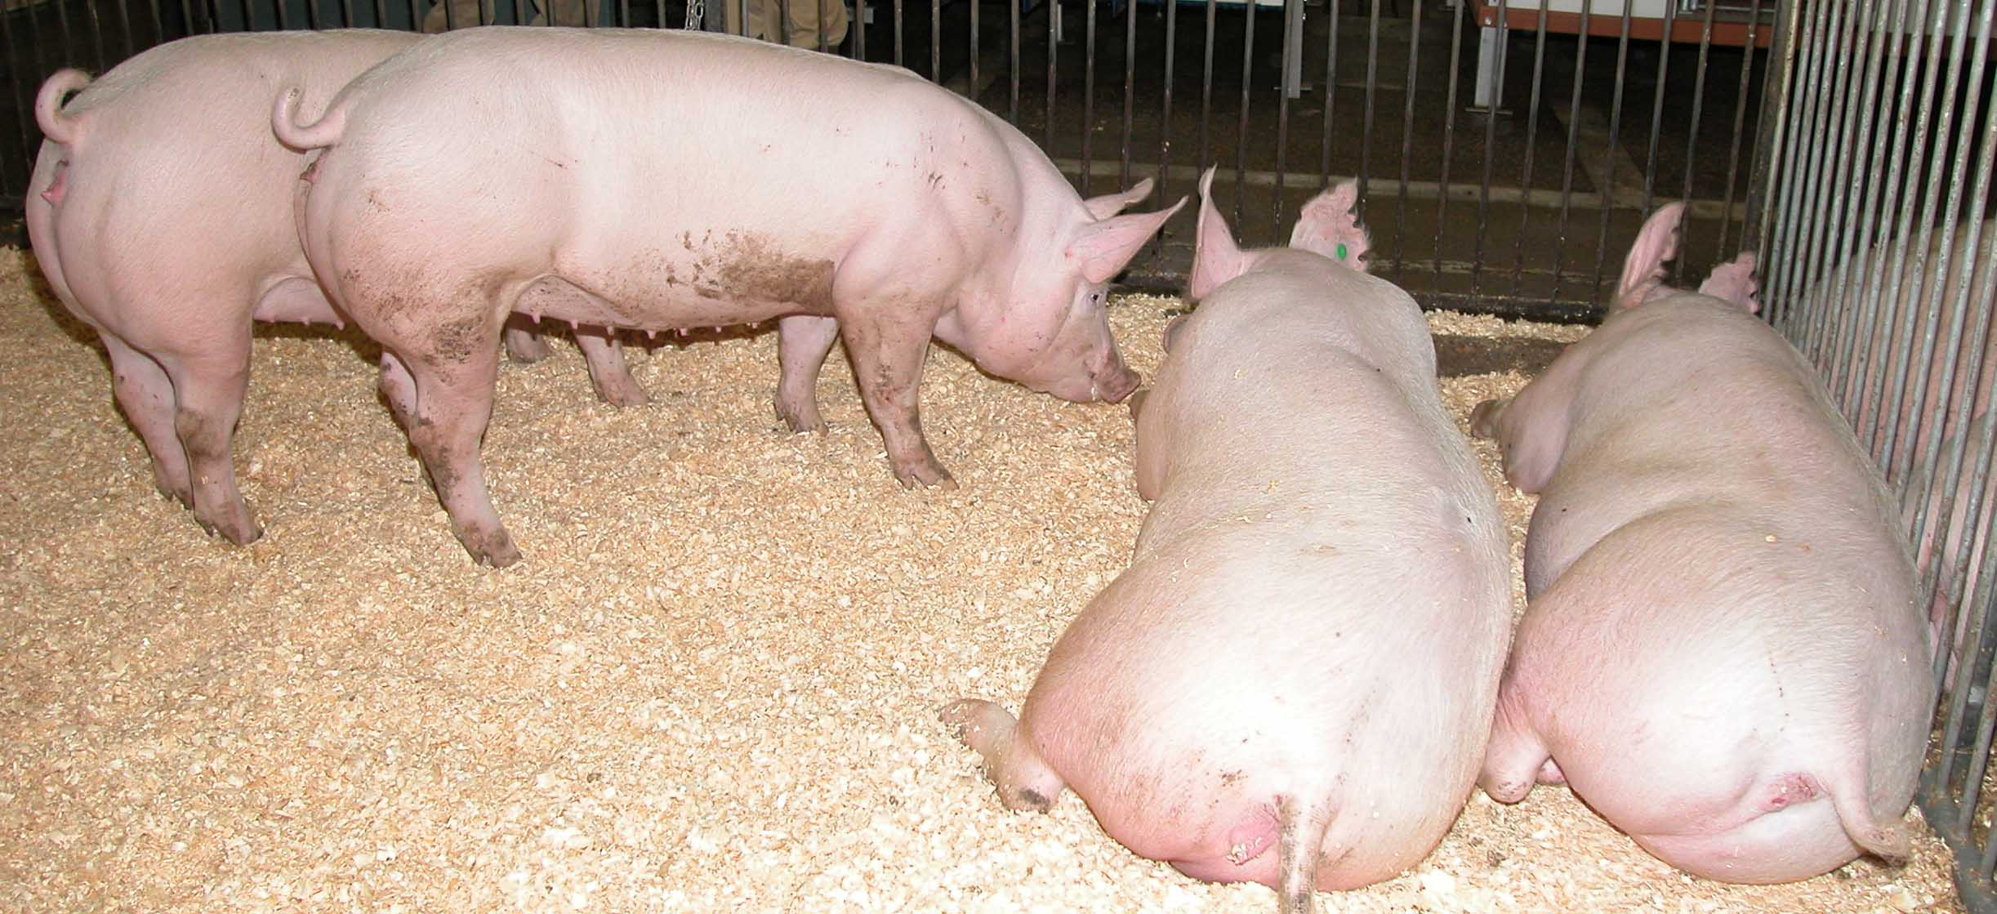
Can you tell which pigs are Enviropigs?

Slide 3
Can we test if a pig is transgenic or non-transgenic?
How are Enviropigs and non-transgenic pigs different?
How can we use this information to design a transgenic test?
Transgenic Enviropig
Non-transgenic pig

Slide 4
Comparing Enviropigs vs. non-transgenic pigs
Transgenic Enviropig
Non-transgenic pig
Contains a transgene
Promoter from a mouse expressing in salivary gland
Coding region from E.coli for phytase
Produces protein, phytase, in the salivary glands, secreted in the saliva
Can digest phytate
Low level of phosphorus in feces
Does not contain a transgene
Does not produce protein, phytase
Can not digest phytate
High levels of phosphorus in feces

Slide 5
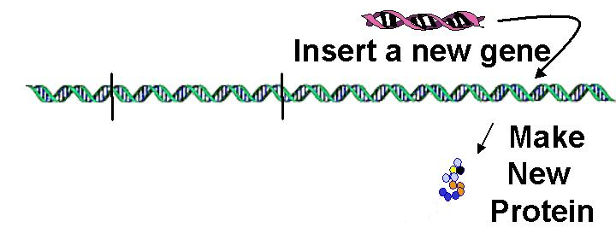
What can we test?
When we design a transgenic organism….
Now, we can test the organism to check if the gene or the protein it codes for are present

Slide 6
Testing for a gene
Go to passel.unl.edu/ge/enviropig to familiarize yourself with how Dr. Forsberg and his team identified the phytase transgene (look at the fourth step).
Complete the two animations in that step by going to these links:
http://passel.unl.edu/pages/animation.php?a=PCR.swf
http://passel.unl.edu/pages/animation.php?a=Gel_electrophoresis.swf
Answer the follow-up questions on your worksheet

Slide 7
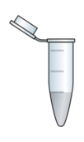
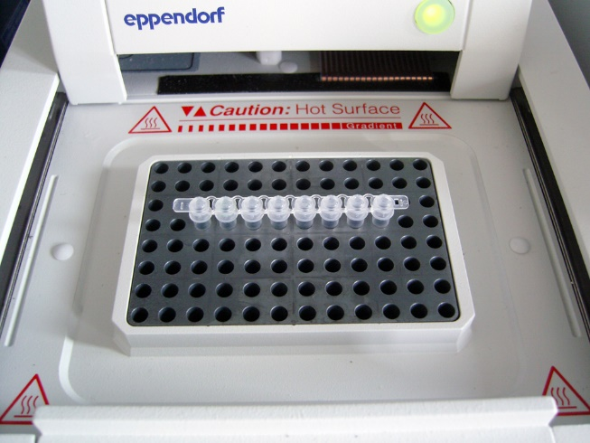
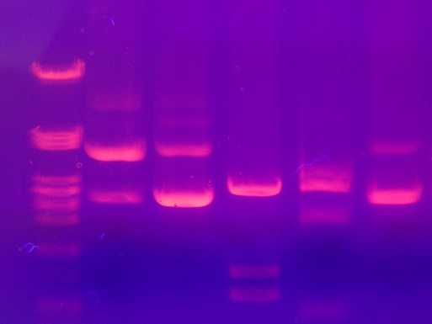
Testing for a gene
2
1
Sample DNA is collected from pig
DNA is extracted from cells and purified
Customized primers, DNA polymerase, and nucleotides are added
5
4
3
DNA sample is placed in agarose gel
Electricity is applied to move the DNA through pores in the gel
Large DNA pieces move slower than small DNA pieces
Sample added to thermocycler
Gene is copied billions of times
Bands of DNA are viewed using UV light

Slide 8
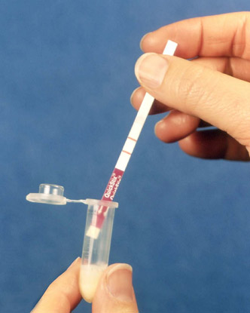
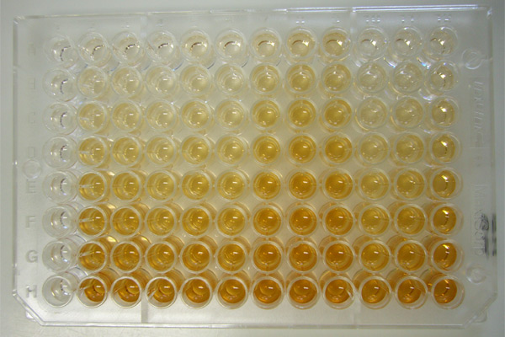
Testing for protein
Yes
No
Lateral flow test
Tests for presence/absence of protein
ELISA test
Tests for how much protein
C
1
2
3
4
5

Slide 9
Testing for protein
Both the lateral flow test and ELISA test rely on the use of antibodies to test for presence of a particular protein (also called an antigen)
Specific antigen-antibody interactions are necessary for binding to take place
In the case of Enviropigs, the antigen of interest is the enzyme, phytase
Antigen
Y
Antibody

Slide 10
Lateral flow test
A rapid antibody-based method used for measuring GMO protein in unprocessed material
Uses a detection surface comprised of immobilized GMO protein-specific antibodies on a solid strip
Suitable for field testing
Watch an animation to learn how a lateral flow test works: https://passel.unl.edu/pages/animation.php?a=latflow07d2.swf

Slide 11
ELISA test
Enzyme-Linked ImmunoSorbent Assay
An antibody-based method used for measuring GMO protein in unprocessed material
Uses a detection surface comprised of immobilized GMO protein-specific antibodies in a multi-well solid plate format
Performed in a laboratory setting

Slide 12
ELISA test
Watch an animation to learn how an ELISA test works: http://www.sumanasinc.com/webcontent/animations/content/ELISA.html
Enzyme substrate
Y
Enzyme-labelled detection antibody
Antigen of interest (Phytase protein)
Y
Capture antibody

Slide 13
Reflection and Extension
Why is DNA analysis or protein detection an important part of the genetic engineering process?
How might this testing be applied to safety testing of GMO’s by regulatory agencies?

Slide 14
Enviropig risks and benefits
Discuss as a class:
Was genetic engineering successful in producing transgenic pigs with low phosphorus manure?
Are these Enviropigs part of the food system?
Was the use of genetic engineering to solve this environmental problem a ‘good idea’?
What can we learn about the application of genetic engineering to solve future problems with food, health, or the environment?

Slide 15
Enviropig risks and benefits
To learn more about Risks and Benefits of the Enviropig, watch the video: https://ge.unl.edu/enviropig/risks-and-benefits/

