Slide 1
Nutrient Pollution and Environmental Problem Solving

Slide 2
Views on the Environment
We will read statements regarding protection of the environment
Think about your level of agreement with the statement
Move to the station that best fits your opinion
Strongly agree
Agree
Neutral
Disagree
Strongly disagree
Be prepared to share your reasoning

Slide 3
Views on the Environment
Individuals have a responsibility to protect the environment.
Government agencies have a responsibility to protect the environment.
Businesses or corporations have a responsibility to protect the environment.
Notes:
Read each statement.
Instruct students to move to different stations in the classroom designated as strongly agree, agree, neutral, disagree, strongly disagree.
Tally responses for each station.
Discuss student reasoning for their answers.

Slide 4
Views on the Environment
Cost should be considered when solving an environmental issue.
Safety should be considered when solving an environmental issue.
Aesthetics should be considered when solving an environmental issue.
Public perception should be considered when solving an environmental issue.
Notes:
Read each statement.
Instruct students to move to different stations in the classroom designated as strongly agree, agree, neutral, disagree, strongly disagree.
Tally responses for each station.
Discuss student reasoning for their answers.
Follow-up by discussing any other aspects that should be considered when solving an environmental issue.

Slide 5
Examining an Environmental Issue: Nutrient Pollution
What is the problem?
Why is it a problem?
http://www.epa.gov/nutrientpollution/problem
Notes:
Have students use the web address provided to learn more about nutrient pollution. Add answers to the PowerPoint.

Slide 6
Examining an Environmental Issue: Nutrient Pollution
What are sources of nutrient pollution?
http://www.epa.gov/nutrientpollution/sources-and-solutions
Notes:
Have students use the web address provided to learn more about nutrient pollution. Add answers to the PowerPoint.

Slide 7
Examining an Environmental Issue: Nutrient Pollution
What are the effects of nutrient pollution?
On humans
On the environment
http://www.epa.gov/nutrientpollution/effects-human-health
http://www.epa.gov/nutrientpollution/effects-economy
http://www.epa.gov/nutrientpollution/effects-environment
Notes:
Have students use the web address provided to learn more about nutrient pollution. Add answers to the PowerPoint.

Slide 8
Examining an Environmental Issue: Focus on Phosphorus Pollution
Now, we will focus on phosphorus pollution due to realities of agricultural animal production.
Listen to the news report “How Mass-Produced Meat Turned Phosphorus Into Pollution” (4:35) http://www.npr.org/sections/thesalt/2014/01/02/257393870/how-mass-produced-meat-turned-phosphorus-into-pollution
Work together to draw an illustration explaining how the challenges in agricultural animal production contribute to nutrient pollution

Slide 9
Brainstorm solutions to phosphorus pollution
What steps in the process could be changed to avoid phosphorus pollution of waterways?
Brainstorm on your own and develop an idea for a potential solution.
Work with a partner to discuss, compare, and provide feedback on solutions. Write how your solution addresses the problem and any advantages or disadvantages for consumers, producers, and the environment.

Slide 10
Introducing a biotechnology solution
Researchers from the University of Guelph in Ontario, Canada led by Dr. Cecil Forsberg developed a biotechnology solution to potentially solve the phosphorus pollution problem associated with pig manure.
What is biotechnology?
How might it be applied to fix this problem?
Image of Dr. Cecil Forsberg from www.uoguelph.ca

Slide 11
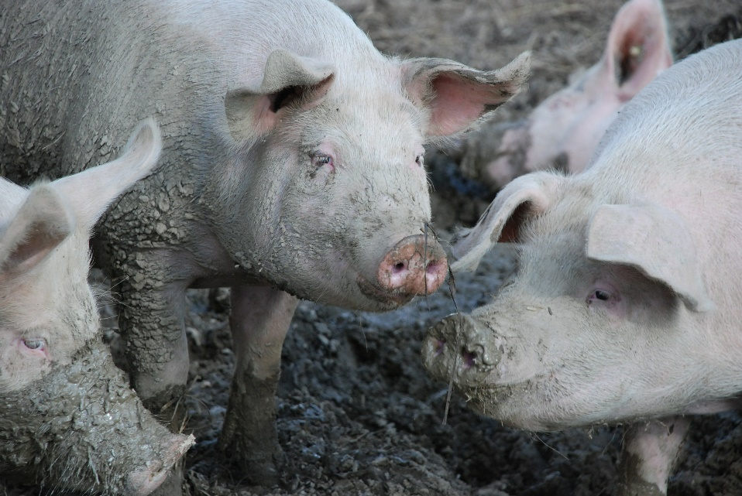
Introducing Enviropigs
Read the news article “Scientists improve transgenic ‘Enviropigs’” from Science Daily, March 7, 2013:
https://www.sciencedaily.com/releases/2013/03/130307124802.htm
What are Enviropigs?
How are they different from non-transgenic pigs?
Image of non-transgenic pigs from pixabay.com
Notes:
From Science Daily: “Phosphorus is crucial for healthy growth in pigs. Unfortunately, 50 to 70 percent of the phosphorus in grain is in the form of phytic acid, a compound indigestible by pigs. Because of this, many farmers have to supplement pig diets with an enzyme called phytase. Phytase breaks down phytic acid and helps pigs digest more of the nutrient. The phytase enzyme has a hefty price tag for farmers, and the enzyme can be accidentally damaged or destroyed when farmers mix feed.
The Enviropig was created to solve this problem. The transgenic pig synthesizes phytase in its modified salivary glands, eliminating the need for additional supplements or enzymes in the feed. By digesting more phosphorus, the Enviropig also produces less phosphorus in its waste.

Slide 12
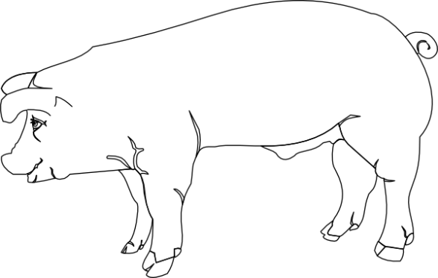
Understanding Enviropigs
Using the words salivary glands, phytate, phytase, phosphate, and phosphorus, draw diagrams explaining how Enviropigs are different from non-transgenic pigs.
What are some potential benefits and challenges you might predict if this solution was adopted?
Transgenic Enviropig
Non-transgenic pig

Slide 13
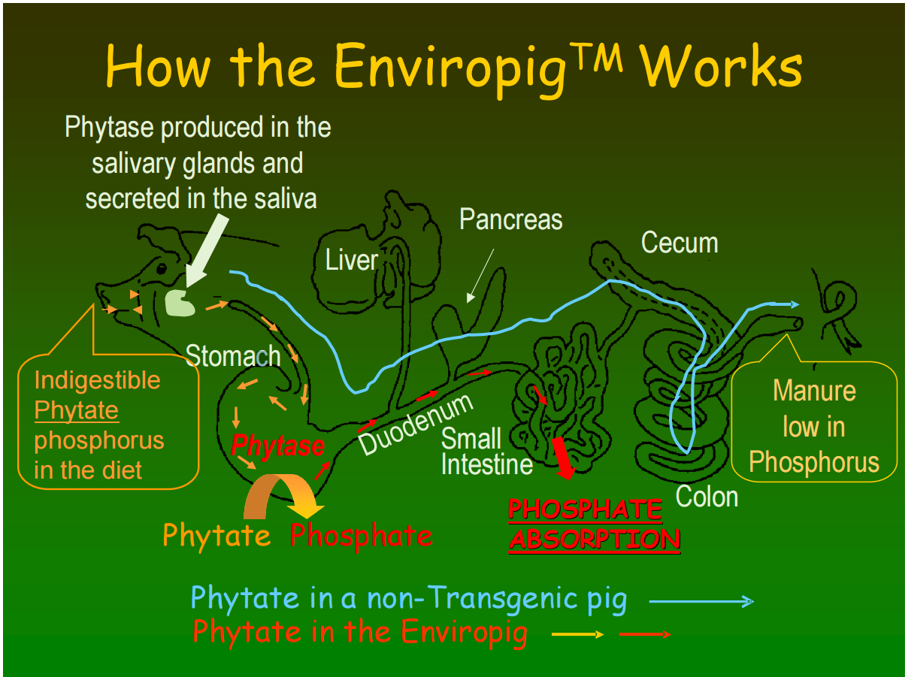
Notes:
Compare student diagrams to this diagram for accuracy.

