Slide 1
Increasing Production with Precision Agriculture

Slide 2
https://www.youtube.com/watch?v=2jF2IsicDC4

Slide 3
Finding Solutions for Life on a Small Planet
Projected increase in world population by 2050 will add 2 billion people to the planet
Growing world population requires more food, water, energy, goods, medical technologies
Limited resources demand we do more with less, without degrading our natural world

Slide 4
What are some examples of technology that farmers are using today?
Notes:
Have students begin talking in small groups. Then bring class together to discuss the question as a whole class.
Students may discuss GPS, maps, cell phones, computers, large machinery (tractors) with automated features, etc.
Students may talk about how technology makes farming more efficient.

Slide 5
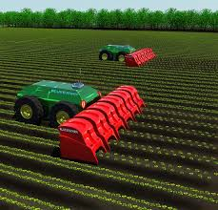
Advanced Agricultural Practices
Global Positioning System (GPS) guidance systems
Variable rate application
Water use efficiency
Yield mapping systems
Agricultural robots
Click on the picture above to watch a video of an agricultural robot working in the field
Notes:
Discuss how farmers/producers use each of the following technologies or practices. Discuss how these practices or technologies might be used in conjunction with one another.
Global Positioning System (GPS) is a space-based satellite navigation system that provides location and time information in all weather conditions, anywhere on or near the Earth. This system can be used to see the topography of the land and boundaries of fields. Used with large machinery such as tractors, GPS units can be used to guide automated machinery or agricultural robots.
Variable rate application is a practice used by farmers apply specific amount of water, fertilizer, etc. to match the needs of a specific area in the field.
Yield mapping systems allow farmers to reduce inputs such as water, fertilizer, etc. by visualizing differences in production in a field and planning how inputs are applied accordingly.
Agricultural robots are driverless machines that plant, harvest, or in some way help in production of a crop.
Water use efficiency (WUE) is a calculation of the ratio of water used in plant metabolism to water lost by the plant through transpiration. This calculation is used to determine how much water should be applied in a particular section when using variable rate application.

Slide 6
Variable-rate application (VRA) control technologies:
Applying different rates of an input to match the needs of a specific area
Inputs may include:
Seed
Fertilizer
Nutrients
Lime
Water
Yield map of soybean field
Notes:
Variable rate can be used with any number of inputs that are used in crop production. It simply means applying different rates of an input to match the needs of a specific area in the field. Seed, fertilizer, nutrients, and water can all use variable-rate technology.

Slide 7
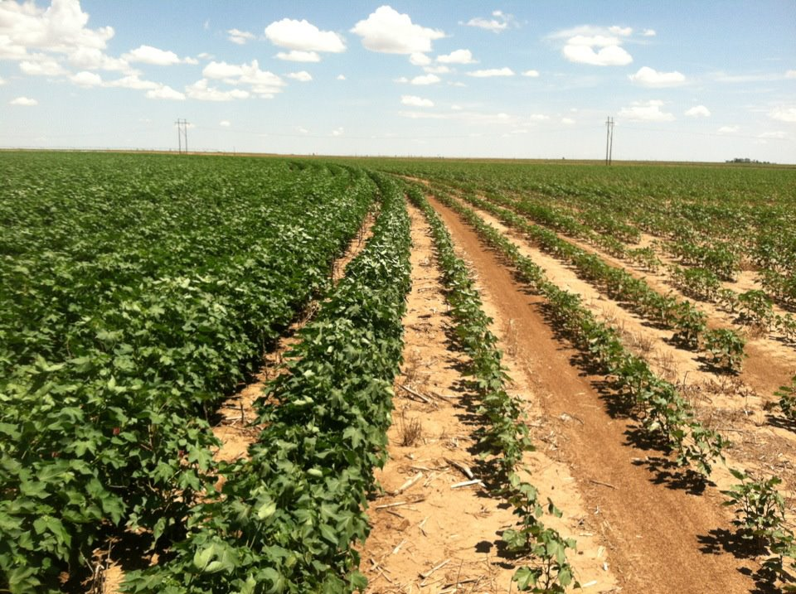
Variable Rate Irrigation
Provides exactly the right amount of water to each foot/meter of the field
Notes:
Discuss with students:
How does the availability of water impact crop growth?
Water is essential for crops to grow. Without water, crops would not flourish.
In this field, is adequate water being applied to particular areas of the field? Where is more water needed?
It appears that adequate water is being applied to the left side of the field. More water is needed on the right side.
Imagine that all the crops in this image are receiving the same amount of water, what environmental factors might be impacting the plant growth in this field?
The type of soil could play a factor. The use of fertilizers and herbicides could also have an impact on crop growth.

Slide 8
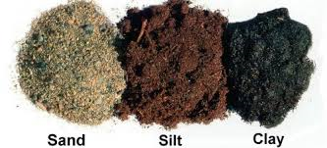
Types of Soil
Lowest water holding capacity
Highest water holding capacity
Notes:
Discuss how soil influences the amount of water contacting the plant roots. Discuss how this may impact crop productivity.
Clay holds most moister of the 3 types of soil. This allows the roots to soak in the water for a longer time. Water easily runs through sand while it is more difficult for it to run through clay.

Slide 9
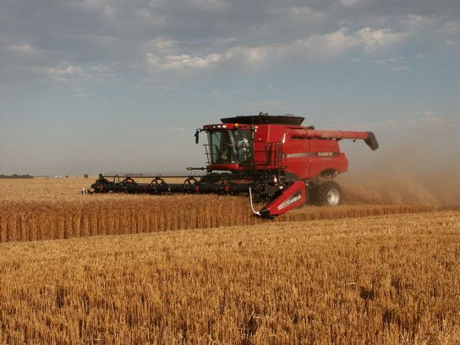
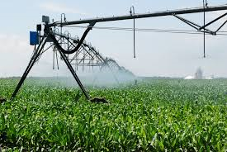
The Goal of Variable Rate Irrigation
Crop Yield
Water Use
Notes:
Why would farmers want to use variable rate irrigation?
To optimize water usage while achieving higher yields. The ultimate goal of agriculture is to increase yields while decreasing the amounts of resources needed to produce them.

Slide 10
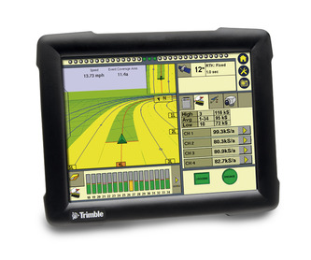
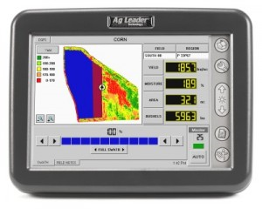
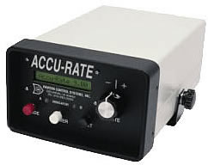
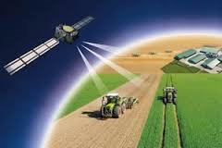
VRA is possible by integrating different technologies
GPS Unit are used by farmers to create field maps to determine a field’s boundaries.
Field computers allow farmers to control the application of fertilizers, herbicides, and pesticides through automated delivery systems.
Rate controllers make it possible for farmers to control how much irrigation, fertilizer, etc. is applied in a field.
Telematics allows information collected in a field to be transferred to the internet.
Notes:
Variable rate irrigation is made possible by the use of the GPS, field computer, rate controller, telematics, and meter.
GPS is used by farmers to create field maps to determine a field’s boundaries.
Field computers allow farmers to control the application of fertilizers, herbicides, and pesticides through automated delivery systems. Farmers are able to monitor yields and moisture using computers.
Rate controllers make it possible for farmers to control how much irrigation, fertilizer, etc. is applied in a field.
Telematics allows information collected in a field to be transferred in the internet.

Slide 11
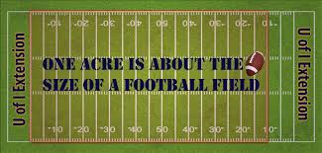
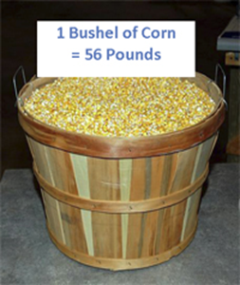
Vocabulary Terms
Irrigation: the artificial application of water to the land or soil
Pivot: equipment used to irrigate fields (large sprinkler)
Acre: a unit of area equal to 43,560 square feet
Section: one square mile of land (640 acres)
Bushel: a measure of capacity usually for dry goods equal to 64 pints
Yield: measure of grains or seeds generated from a unit of land (agricultural output)
Notes:
Let’s review some basic vocabulary terms before continuing on with the lesson.
Irrigation: the artificial application of water to the land or soil
Pivot: equipment used to irrigate fields (large sprinkler)
Acre: a unit of area equal to 43,560 square feet (about the size of a football field)
Section: one square mile of land (640 acres)
Bushel: a measure of capacity usually for dry goods equal to 64 pints
Yield: measure of grains or seeds generated from a unit of land (agricultural output)

Slide 12
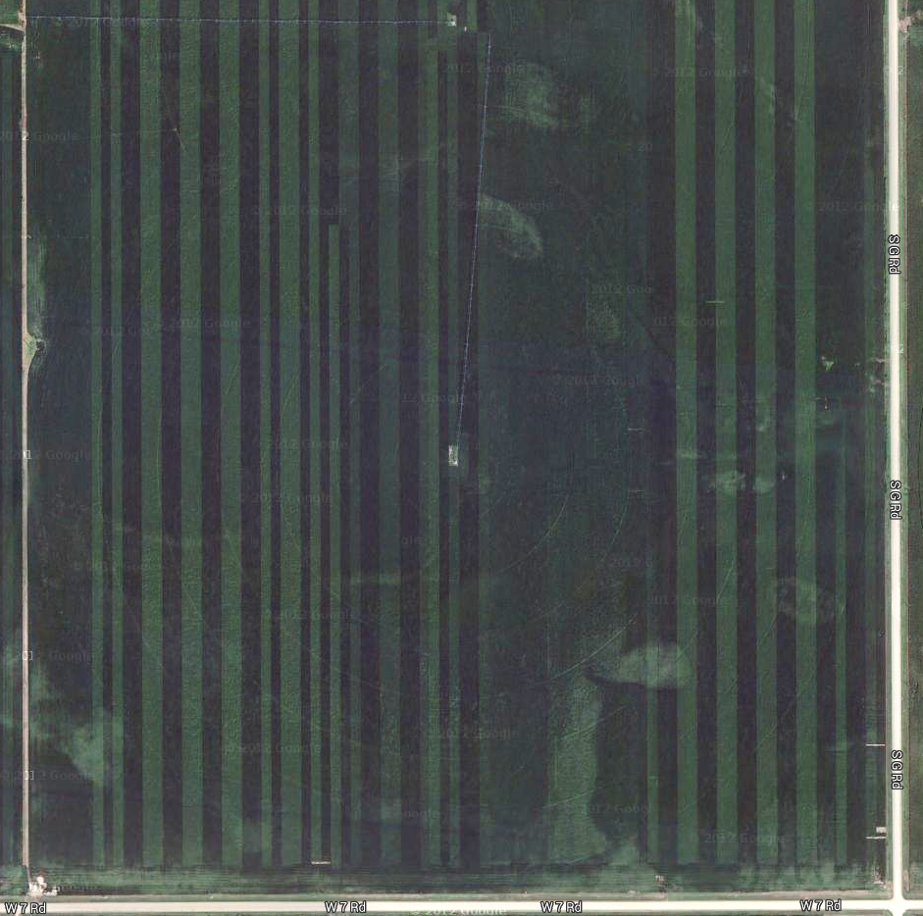
Center Pivot
Irrigated land
Notes:
So how is water delivered to a crop? Let’s take a look at irrigation!
We’re looking at a field in central Nebraska from a bird’s eye view and a landscape view that uses center pivot irrigation on a quarter section (160 acres). The pivot is visible (almost running directly North) in the aerial photograph, denoted by the red arrows in both images. It travels in a circle (or pivots) around the center point, providing water to the crop. This is like a giant sprinkler.
Everything within the yellow circle is considered irrigated land. Everything outside the yellow circle is not being provided water from the pivot.

Slide 13
How can we use variable rate irrigation to maximize yield?
Notes:
Using harvester yield monitors (precision agriculture technologies), we can estimate the corn yield across the field and see how some portions of the field yielded very high (green) and some places very low (red). Areas where the pivot irrigated are within the six zones (pie pieces) drawn on the map. You’ll see the dry land corners that were not irrigated seem quite low in most cases (but not all).

Slide 14
Example: Water Use Efficiency (WUE)
WUE = Irrigated Yield – Dry land Yield
Irrigation
Irrigated yield: 190 bushels/acre
Dry land yield: 168 bushels/acre
Irrigation: 10 inches
WUE= 190bushels/acre - 168 bushels/acre
10in
WUE=2.20 bushels/acre inch
Notes:
Dry land is essentially non-irrigated crop land.
The WUE of 2.2 bushels/acre inch means that this farmer should get 2.2 bushels of corn per inch of irrigation applied per acre of land farmed.

Slide 15
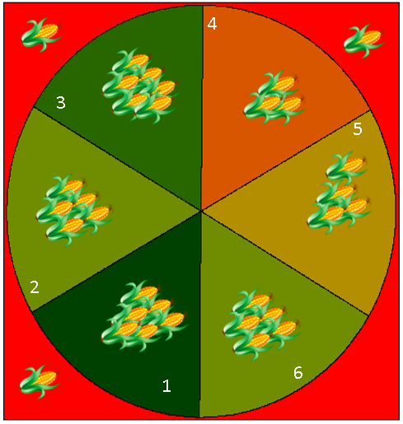
Corn Yield
Bushels /acre
Zone 1: 198
Zone 3: 195
Zone 2 & 6: 194
Zone 5: 190
Zone 4: 175
Dryland: 168
WUE = Irrigated Yield – Dry land Yield
Irrigation
Notes:
Remind students that the corn within the circle is considered irrigated (remember this is because the pivot is providing water to this area). The corn outside the circle is considered dryland.

Slide 16
Calculate WUE for each section
WUE = Irrigated Yield – Dry land Yield
Irrigation
Notes:
Use as instructions for student worksheet.

Slide 17
Section WUE
(bu/ac·in)
4
Yield=195bu/ac
WUE=____
Yield=175bu/ac
WUE=____
3
5
Yield=194bu
WUE=____
Yield=190bu/ac
WUE=____
2
Yield=198bu/ac
WUE=____
Yield=194bu/ac
WUE=____
6
1
Irrigation=10in
Notes:
Students will work individually to calculate the WUE for each section.

Slide 18
Section WUE
(bu/ac·in)
4
Yield=195bu
WUE=2.7
Yield=175bu
WUE=0.7
3
5
Yield=194bu
WUE=2.6
Yield=190bu
WUE=2.2
2
Yield=198bu
WUE=3.0
Yield=194bu
WUE=2.6
6
1
Irrigation=10in
Notes:
Review answers with students.

Slide 19
Use WUE calculations to determine how much water should be applied to each section to match the average water efficiency for the irrigated field.
Irrigation = Irrigated Yield – Dry land Yield
WUE
Notes:
Explain to students that you can rearrange the equation to solve for how much water needs to be applied to each section of the field.

Slide 20
Example: Irrigation
Irrigation = Irrigated Yield – Dry land Yield
WUE
Irrigated yield: 190 bushels/acre
Dry land yield: 168 bushels/acre
WUE: 2.2 bushels/acre inch
Irrigation= 190bushels/acre - 168 bushels/acre
2.2 bushels/acre inch
Irrigation = 10 inches
Notes:
Dry land is essentially non-irrigated crop land.
The WUE of 2.2 bushels/acre inch means that this farmer should get 2.2 bushels of corn per inch of irrigation applied per acre of land farmed.

Slide 21
Irrigation
4
Yield=195bu/ac
I=____in
Yield=175bu/ac
I=____in
3
5
Yield=194bu/ac
I=____in
Yield=190bu/ac
I=____in
2
Yield=198bu/ac
I=____in
Yield=194bu/ac
I=____in
6
1
WUE=2.2
(bu/ac·in)
Notes:
I= irrigation
Bu = bushel
Ac = acre
In = inch

Slide 22
Irrigation
4
Y=195bu
I=12.3in
Y=175bu
I=3.2in
3
5
Y=194bu
I=11.8in
Y=190bu
I=10.0in
2
Y=198bu
I=13.6in
Y=194bu
I=11.8in
6
1
WUE=2.2
(bu/ac·in)
Notes:
Review answers with students.

Slide 23
Irrigation allowed for the production of an extra 3,000 bushels of corn!
American Corn Growers
Foundation
Notes:
This semi truck can carry approximately 1,000 bushels. Each bushel is equivalent to 56 pounds.
Consider having students calculate how much additional money this farmer by irrigating a field using variable rate irrigation. (USDA is now projecting 2014-15 yearly average corn prices in a range of $3.65-4.35 per bushel, or an average of $4 per bushel, which again could be too high if national yields increase.)

Slide 24
Yield Map Data Improves Efficiency
By adjusting irrigation distribution, we can save 4.3 million gallons of water in one section!
Notes:
A water tower typically holds 1 million gallons of water.
By adjusting irrigation distribution, we can save 4.3 million gallons of water in one section.
Why is conserving water important?
Decrease inputs used in agricultural production.

Slide 25
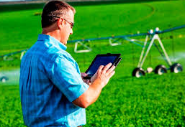
It’s our turn! Variable rate irrigation activity

Slide 26
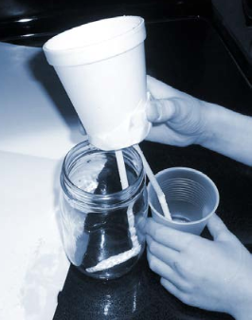
How can we construct a device
that will vary the rate of water flow?

Slide 27
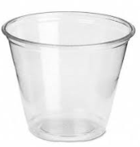
Goal
Divide water into amounts of 2 fl oz,6 fl oz and 8 fl oz
6 fl oz
2 fl oz
8 fl oz

Slide 28
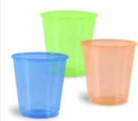
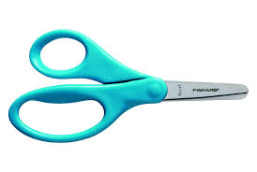
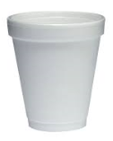
Instructions
Form groups of 3-4 people
Each group will receive:
16 oz. Water Bottle
Styrofoam Cup
3 Plastic Cups
Pair of Scissors

Slide 29
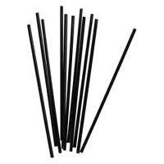
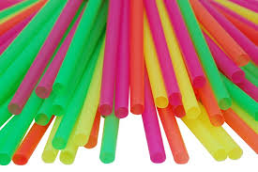
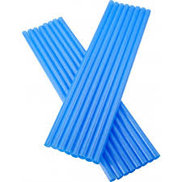
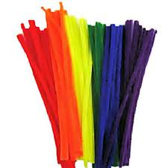
Available Supplies – Choose 2
Regular Straws
Coffee Straws
Jumbo Straws
Pipe cleaners
Notes:
Students are only allowed to choose 2 because they are supposed to work with limited resources!

Slide 30
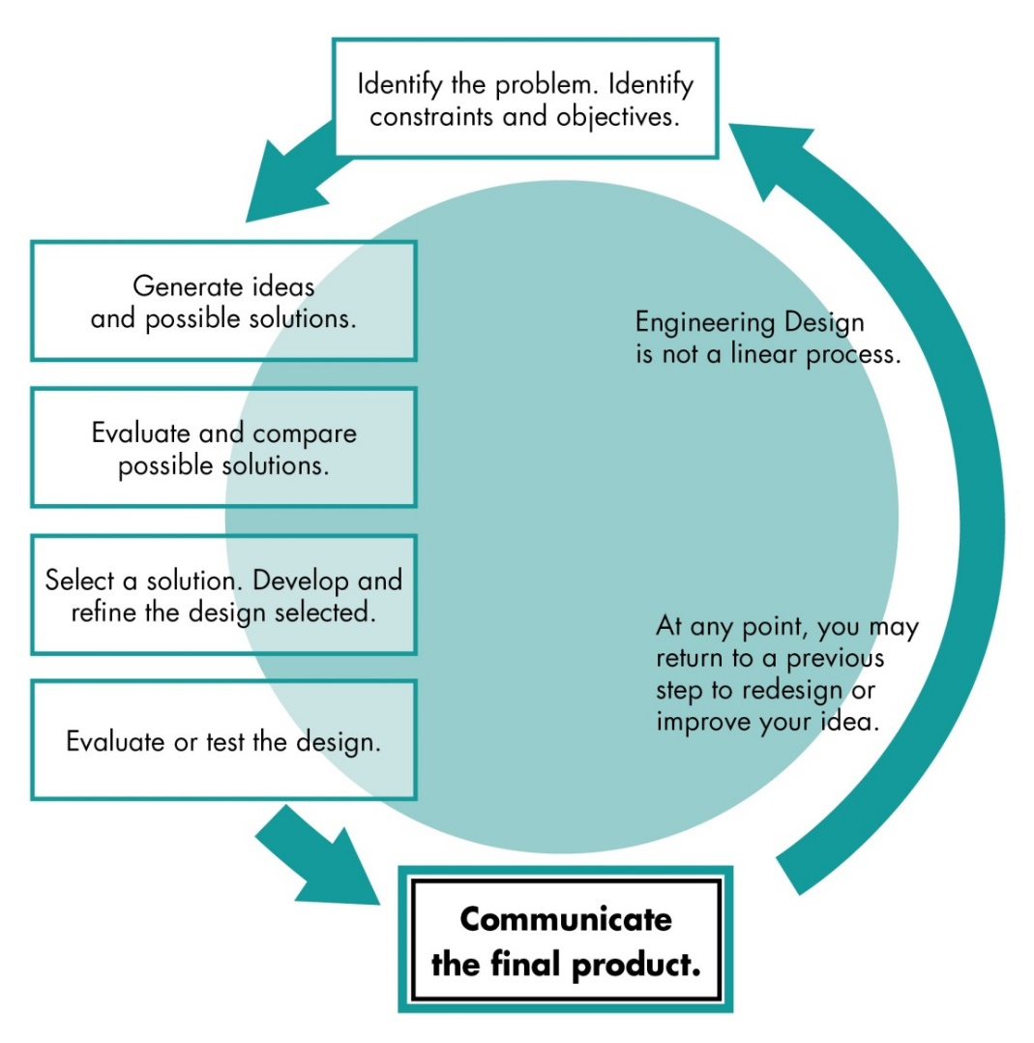
Engineering Design Process
Notes:
Use the engineering design process to structure lesson plan and to get students thinking like engineers!

Slide 31
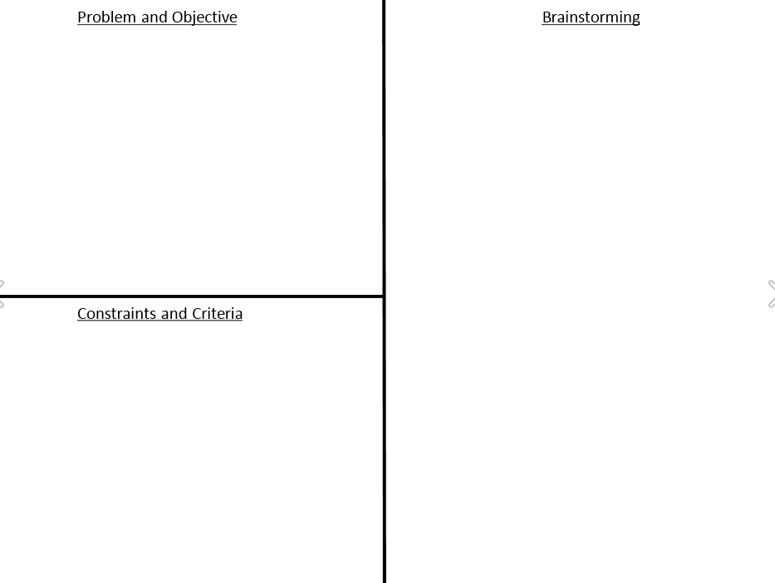
Ex. Need to construct a device to vary water flow
Ex. Differences in straw diameters will play a factor
Ex. Allowed to use only 2 materials (limited resources)
Notes:
Have students complete worksheets.

Slide 32
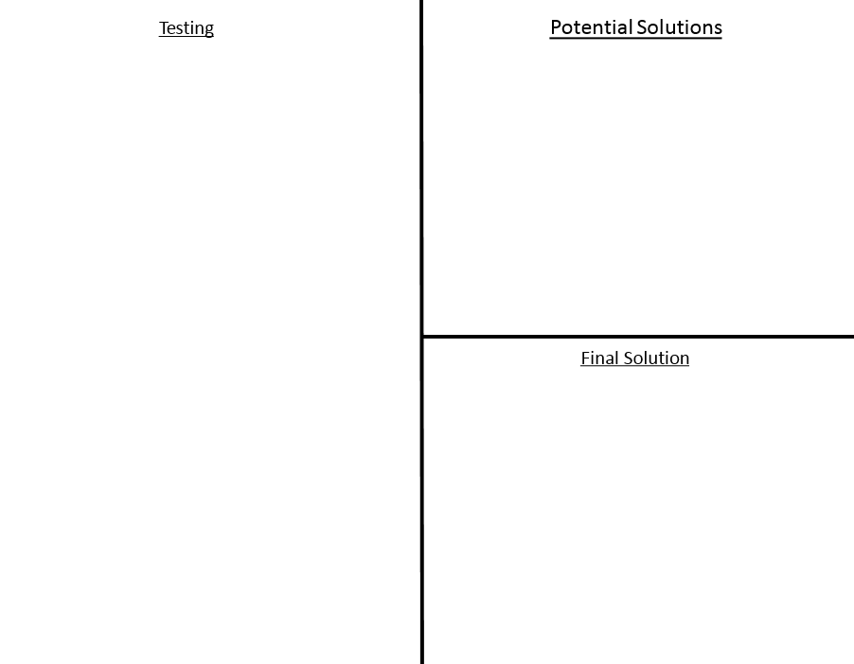
Ex. Water flowed into amounts of 5fl oz, 5 fl oz, 6 fl oz
Ex. Need to use different types of straws
Notes:
Have students complete worksheets. This won’t be completed until after they test devices.

Slide 33
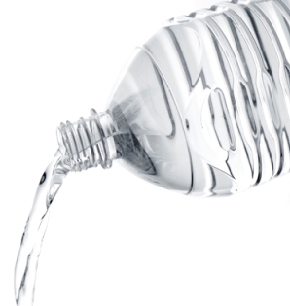
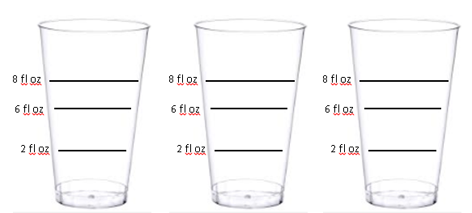
Testing
Pour water bottle into Styrofoam cup
Record how much water actually goes into cups

Slide 34
Reflection
Was your design successful?
What could you have done to improve design?
Why do your think that varying water amounts is useful?

Slide 35
Questions?

