Slide 1
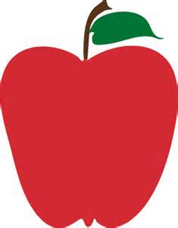
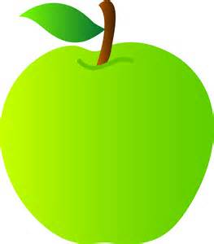
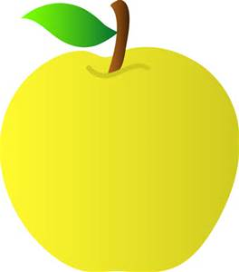
Apple Genetics

Slide 2
Background on Apples
7,500 apple producers in the United States
200 varieties are grown in United States
67% of apples in U.S. are grown for fresh consumption
33% used for processing (juice and slices)
Top 5 apple producing states are
Washington
New York
Michigan
Pennsylvania
California
China produces more apples than any other country
Notes:
Ask students what their favorite apple is. You can even have them bring their favorite apple to class. Students can discuss why they like a particular apple. Share these facts with students. It will give them a picture of how large apple production is throughout the world.

Slide 3
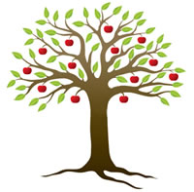
Did you know…?
There is only one apple that is native to North America—the crabapple.
Apples are a member of the rose family.
Apples are 25% air, which is why they float in water.
The average person eats 65 apples per year.
An average-sized apple tree can produce enough apples to fill 20 boxes that weight 42 pounds each.
Notes:
Here are some interesting apple facts. Share these with students. They will probably be amazed by some of them.

Slide 4
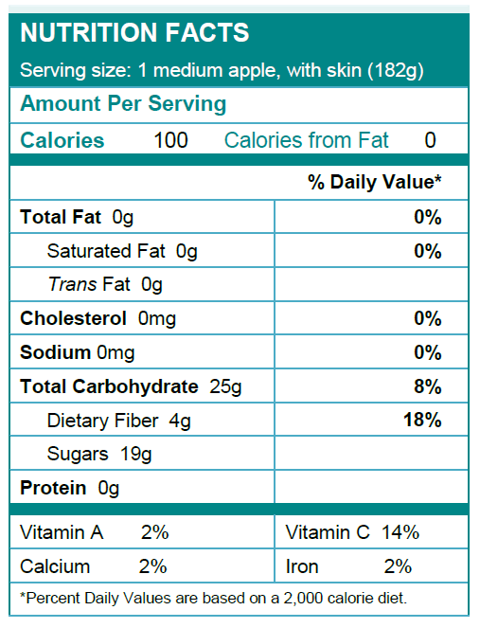
“An apple a day, keeps the doctor away”
Low calorie snack
Provides nearly 20% of daily fiber
Contains no fat
High in vitamin C
Notes:
Apples are a good, healthy snack. That is how the “an apple a day, keeps the doctor away” quote began. The arrows point out the benefits of eating apples.

Slide 5
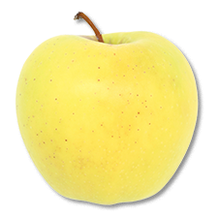
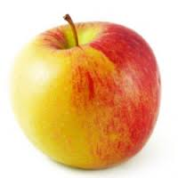
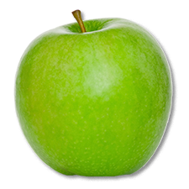
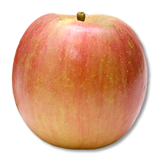
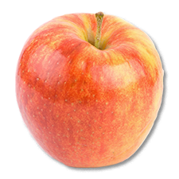
Varieties of Apples
Fuji
Gala
Golden Delicious
Braeburn
Granny Smith
More Sweet
Less Sweet
Notes:
This slide shows a variety of common apples. Apples are used for a variety of purposes such as baking or eating. This shows the spectrum of how sweet or tart apples are. You can ask students if they have ate those apples and if they liked them or not.
http://holykaw.alltop.com/the-spectrum-of-apple-flavors-infographic
http://www.heinens.com/departments/produce/seasonal-best-apples/apple-varieties/

Slide 6
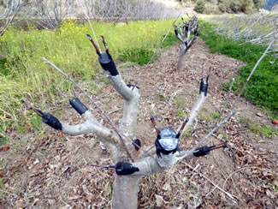
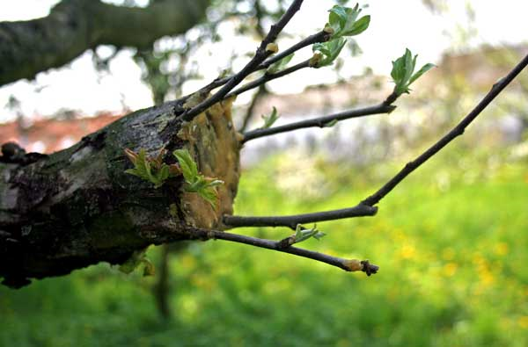
Grafting
Most apples are not grown from seed
Most apple trees originate from method called grafting
A section of a stem with leaf buds is inserted into another tree
Allows the tree to skip the juvenile phase which may last 5-9 years.
Notes:
Students may believe that apple trees grow from seeds. However, a practice known as grafting is used. This is where a section of a stem with leaf buds is inserted into the stock of a tree. This allows the tree to skip the juvenile phase which may have lasted 5-9 years. http://www.writerguy.com/deb/compost/2011Winter/WinterNws10-2011.html
http://www.homengardeningtips.com/grafted-fruit-trees

Slide 7
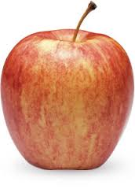
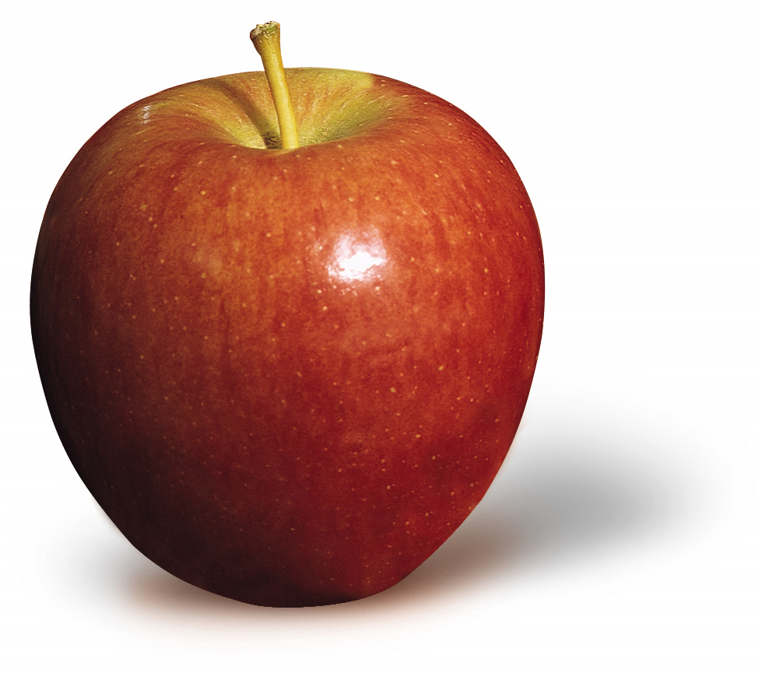
Apple Observations
Gala
Braeburn
Notes:
Students will use worksheets and make observations of these two apples. Form students into groups and give them apples.

Slide 8
Apple Observations
Outside of the Apple
Look
Smell
Touch
Inside of the Apple
Look
Smell
Touch
Taste (tartness, sweetness, juiciness & crunchiness)
Notes:
Students will record their apple observations on the worksheets.

Slide 9
What similarities and differences did you find between the two apples?
Gala
Braeburn
Notes:
Facilitate large group discussion. Ask students what similarities and differences they found between the Gala and Braeburn apple. Ask students which apple they preferred.

Slide 10
Genetics Vocabulary Review
Gene: a section of DNA that codes for a certain trait
Allele: a variant of a gene
Dominant Allele: an allele whose trait always shows up in the organism when the allele is present (written as uppercase letter)
Recessive Allele: an allele that is masked when a dominant allele is present (written as lower case letter)
Genotype: an organism's genetic makeup or allele combinations
Phenotype: an organism's physical appearance or visible trait
Punnett Square: a diagram that is used to predict an outcome of a particular cross or breeding experiment
Homozygous : having 2 identical alleles for a trait
Heterozygous: having 2 different alleles for a trait
Notes:
Review basic genetics vocabulary with students. Use your judgement to see if you need to review these terms with your students.

Slide 11
Apple Genotypes
Here are examples of genotypes that the Gala and Braeburn apples may possess
Tartness is recessive (Gala’s genotype is TT, Braeburn’s genotype is tt)
Sweetness is recessive (Gala’s genotype is ss, Braeburn’s genotype is SS)
Juiciness is dominant (Gala’s genotype is JJ, Braeburn’s genotype is JJ)
Crunchiness is dominant (Gala’s genotype is Cc, Braeburn’s genotype is CC)
Red skin coloring is dominant (Gala’s genotype is RR, Braeburn’s genotype is Rr)
Smooth skin texture is dominant (Gala’s genotype is Bb, Braeburn’s genotype is Bb)
Notes:
When making observations in Part 1, you described traits for each apple such as color, juiciness, or sweetness. The genes in the apple determine these traits. Below are examples of genotypes that the Gala and Braeburn apples may possess. You will use this information to complete Punnett Squares on the following page.

Slide 12
Punnett Square Activity
Complete Punnett Squares for each trait to illustrate genetic cross
Gala Apple Genotype (Male)
T
T
Probabilities
______% TT (very tart)
______% Tt (very tart)
______% tt (not tart)
t
Tt
Tt
0
Braeburn Apple
Genotype (Female)
100
0
t
Tt
Tt
Notes:
Students will complete Punnett Squares for each of the traits on the worksheet. Students will also determine probabilities of possible genotypes.

Slide 13
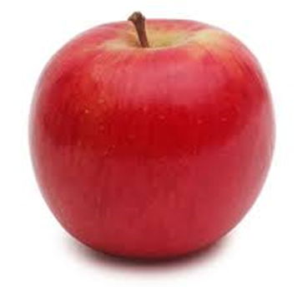
Jazz Apple Observations
Look (outside of apple, inside of apple)
Smell (outside of apple, inside of apple)
Touch (outside of apple, inside of apple)
Taste (tartness, sweetness, juiciness & crunchiness)
Notes:
Students will then observe the Jazz apple. Students will record findings on worksheet.

Slide 14
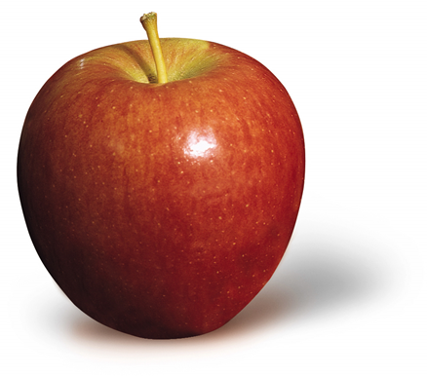
Comparing all 3 apples What similarities and differences did you notice?
Braeburn
Jazz
Notes:
Facilitate class discussion. Ask students how the Jazz apple compared to the Gala and Braeburn apple.

Slide 15
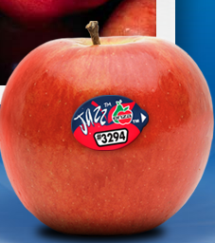
Jazz Apple
Fusion between Gala and Braeburn apple
Developed in New Zealand
Multiple cross pollinations of the Gala and Braeburn occurred, producing 8,500 seedlings to choose as Jazz apple
“Tangy-sweet taste and loud crunch”
Sold internationally in 2001
Grown in New Zealand, Chile, France, and Washington
Notes:
Reveal that the Jazz apple is a cross between the Gala and Braeburn apple. Here are some facts about the Jazz apple. Producing a variety of apple is an intensive process.

Slide 16
Crossbreeding Apples
Jazz apple is the result of crossbreeding
Goal is to make better quality apples
Breeders must look at both genotypes and phenotypes of apples
Must decide on what traits they hope to see in new apple
Often use a backcrossing approach – successive generations of apples with the trait of interest are crossed with different high quality parent apples at each generation
Process typically takes 15 years
Some consider crossbreeding a genetic modification
Notes:
The Jazz apple is crossbred between the Gala and Braeburn. Here are some facts about crossbreeding apples. The goal of crossbreeding is to produce better quality apples and select particular traits they hope to see in their offspring.

Slide 17
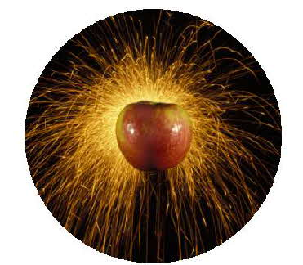
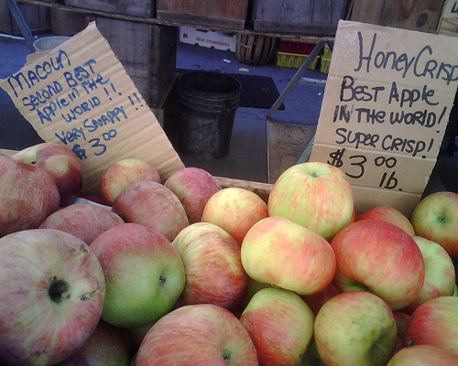
Honeycrisp Apples
Competitor of Jazz apples
Known to be “explosively crisp”
Derived in 1960 from a cross from Macoun and Honeygold apples at the University of Minnesota
Released for commercial propagation in 1991
Notes:
The Honeycrisp apple is a competitor of the Jazz apple. It was also crossbred. The picture of the apples shows the Honeycrisp next to one of its parents. http://www.honeycrisp.com/honeycrisp.html
http://www.vegetablegardener.com/item/9740/here-comes-honeycrisp-apple-season

Slide 18
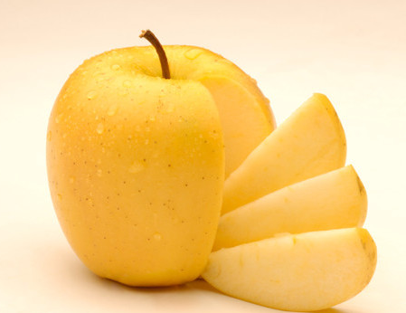
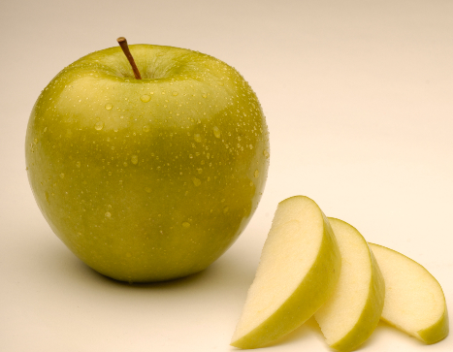
Arctic Apples
“Non-browning apple”
Apples turn brown when bitten, sliced, or bruised.
Enzyme called polyphenol oxidase (PPO) is responsible for browning
Discovered a way to reduce the amount of PPO in Arctic apples
Created Arctic Golden and Artic Granny apples
Notes:
Looking at genetics has also helped researchers develop a non-browning apple. If there are still cut apples in the classroom, ask students if they notice browning occurring on their apples.

