Slide 1
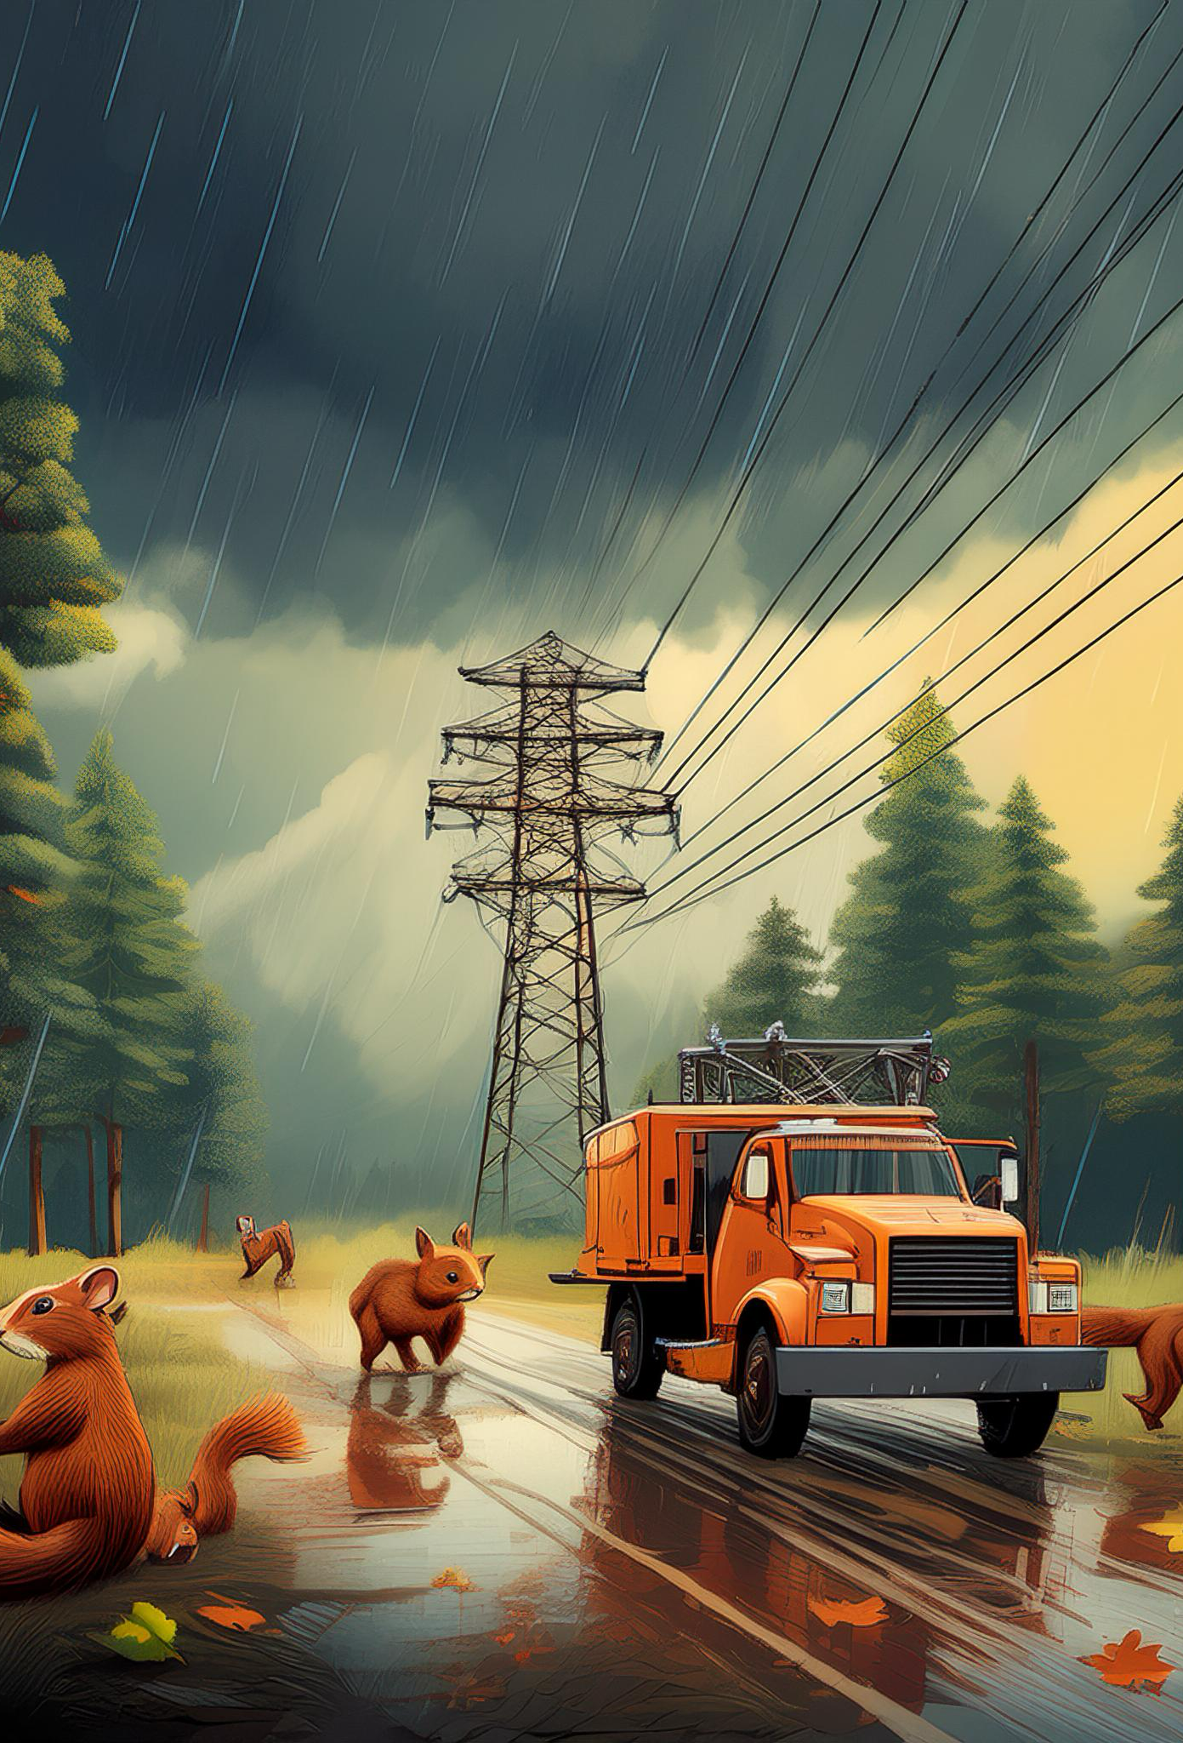
An Educational Guide to Microgrid Mastermind
By: The Game Design Team

Slide 2

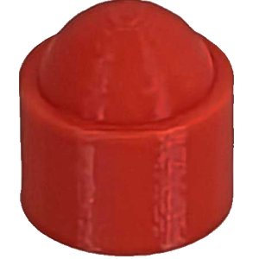
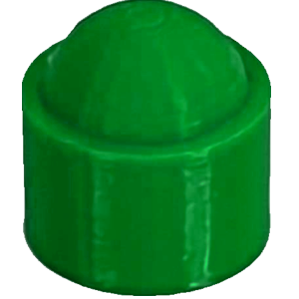

Loads
Load
Marker
Load
Stacker
Generation
Stacker
Real-world name = electrical loads
Load – “any component of a circuit that consumes power or energy” [1]
In context of a power grid
  Electrical Load: total amount of power being consumed by all devices connected to the grid at any given time.
Examples of electrical loads
  Homes, businesses, industrial sites, etc.
Load fluctuates throughout the day.
Generation = load demand at any given time
Notes:
Teaching point: Grids must always match energy supply with demand in real time.
Load fluctuates: Determined by several factors, such as, weather, time of day, and what loads need serviced.
Generation = load: Someone has to predict the amount of energy that will be needed to service these loads, so both energy and money isn’t wasted.

Slide 3
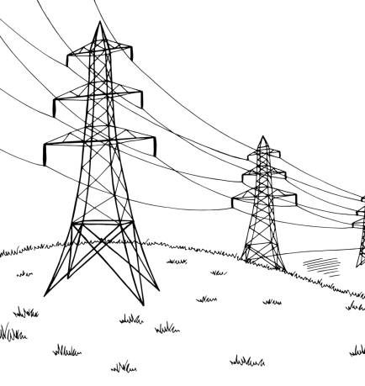
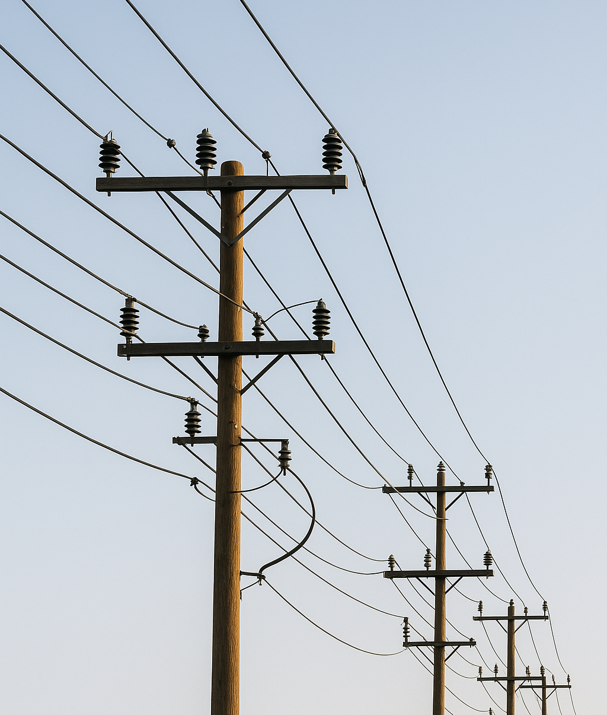
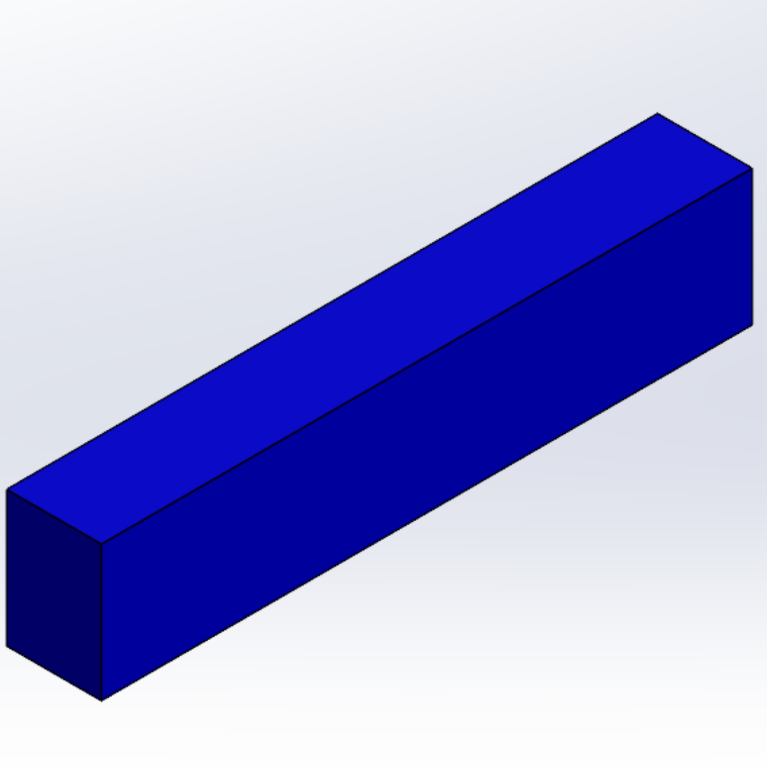
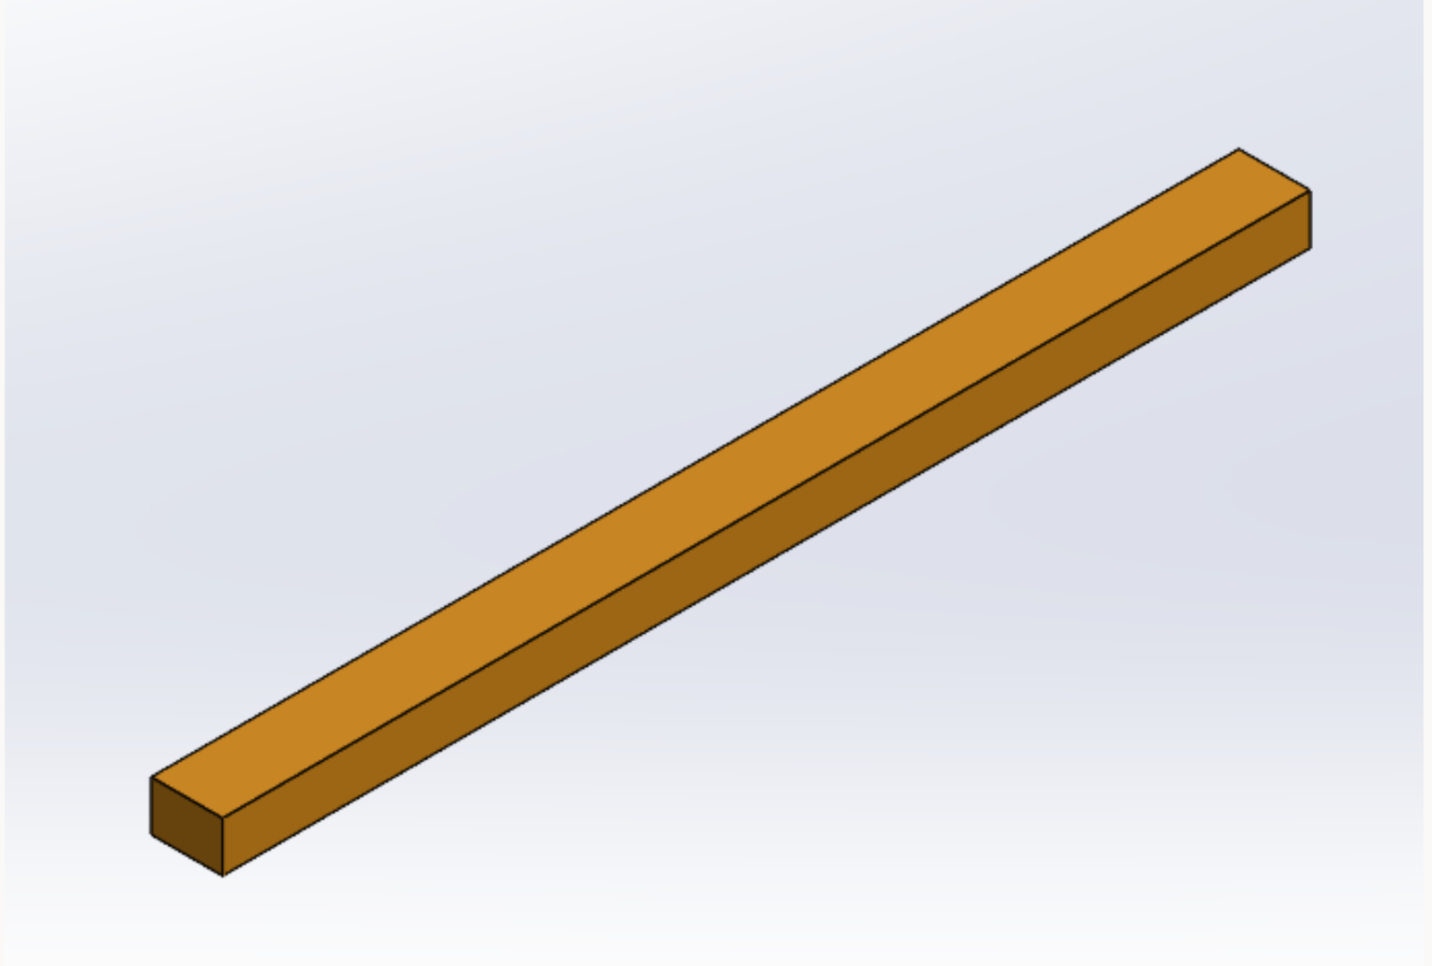
Power Lines
Transmission Lines (orange):
  Transmit high-voltage electricity over long distances like power plants to edge of cities.
Distribution Line (blue):
  Lower-voltage power delivered to homes and cities.

Slide 4
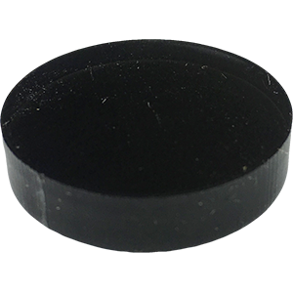
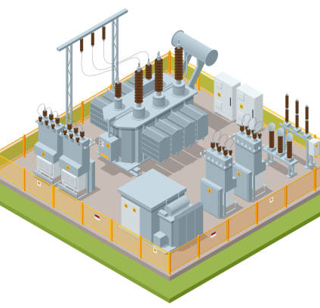
Substations
Substations are vital to the electrical grid, and the ability to use power in our homes and businesses.
Role:
Step Up Voltage
  To transmit the electricity from the power plant into a city or to another state
  Higher voltage can travel farther distances
  Helps minimize power loss during transmission over long distances
Step Down Voltage
  For distribution within cities and neighborhoods.
  Ensures safety, and protects grid from excessive stress
  Makes electricity useable for homes and businesses
Notes:
It steps down voltage from transmission to distribution so it can be used in homes.
Helps route power locally and protects the grid from excessive stress by using transformers to step down the voltage further, ensuring electricity enters at a safe level without overloading the system.

Slide 5
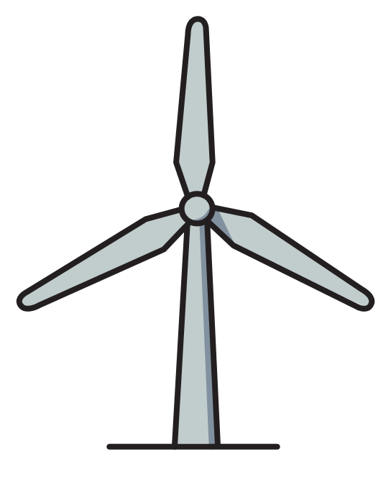
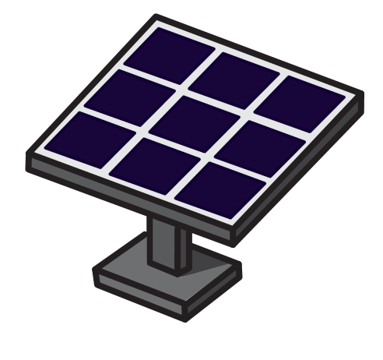

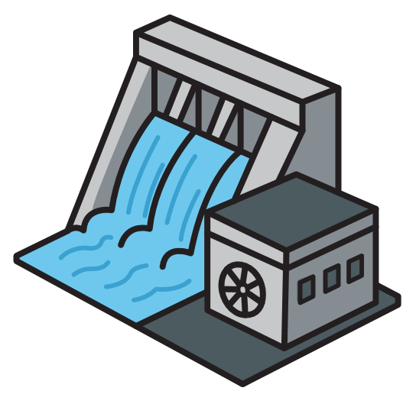


Power Plants
Power plants produce the electricity you use everyday.
Location Matters
Placement is defined by what resources are needed by certain power plants and where those resources exist.
Our grid must be diverse in types of power plants
There must be a balance of non-renewable and renewable.
Generation Capacities
Different power plants can produce more or less power than other power plants
Differs by type & size (game is based on type)
Notes:
Represent real energy generation facilities (solar farms, hydro dams, nuclear, coal, etc.)
Placed on nature tiles to mirror where those resources exist in real life.
These also show that what it takes having multiple different types of energy to be able to have a smooth-running grid, grids cannot just be run off of renewables or non-renewables it takes both.
The generation capacities on the power plants also help to show how some plants can generate more electricity than others because a number of factors like plant size and the material that is being used like nuclear can generate a lot in real life

Slide 6
Power Plant Location Matters
Power Plant: | Must Be Placed in Area(s) With: | Why (Real-World Explanation):
Nuclear | Water | Nuclear reactors produce heat and must be cooled continuously.
Coal | Water | Requires water for cooling steam turbines and scrubbing emissions.
Natural Gas | Water | Need water to keep turbines & generators cool
Hydro | Mountains with water | Need elevation change for gravitational force. The flowing or falling water spin the turbines.
Solar | Plains, desert, or mountains | Sunlight-rich areas provide maximum solar energy. Open land improves panel efficiency.
Wind | Plains, deserts, or lakes | Open, windy areas generate the most consistent wind energy.
Battery | Anywhere (except in a city) | Offers flexible placement near substations or areas with high demand, but not without a high implementation cost.

Slide 7

Battery
Imagine a really big rechargeable battery.
Battery Storage systems are used to maintain a stable and flexible power supply by…
Storing energy when there is a surplus
Distributing it during shortages
In this game:
Used to store surplus generation that you may have after fulfilling the loads in your city.
Notes:
Enables players to store surplus electricity from any powerplant during times when generation exceeds the city's needs.
The stored energy can be used in later rounds to prevent blackouts or handle sudden spikes in the demand during game play.
Demonstrates how real-world energy grids use battery storage systems (like lithium-ion batteries) to maintain a stable and flexible power supply by saving energy during surplus and using it during shortages.
Battery storage units in real life have limited capacity, and the same applies in the game. This helps illustrate that players can only store a set amount of energy, not an unlimited supply.

Slide 8
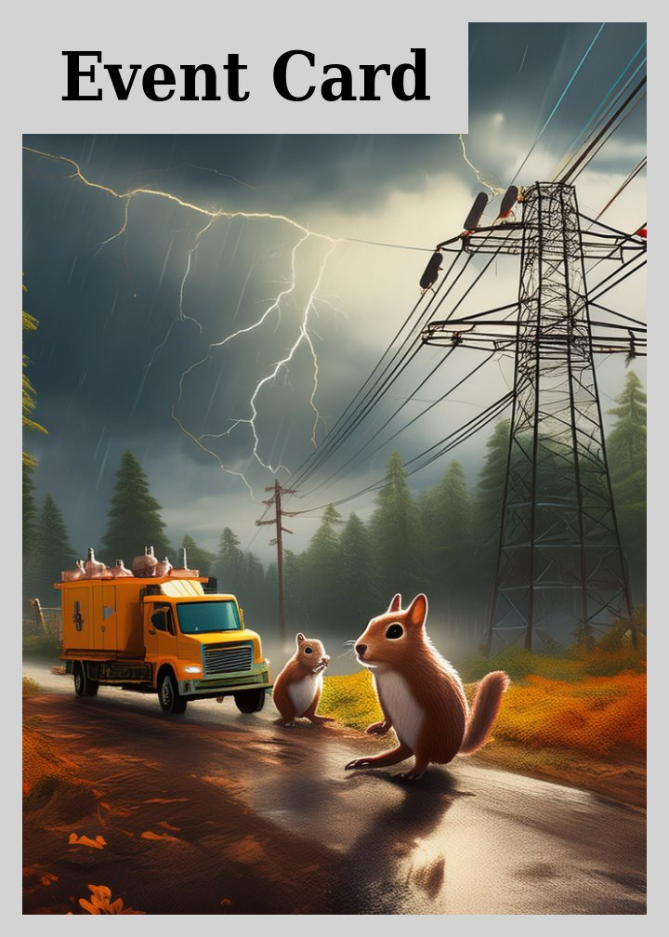
Event Cards
Reflect real-life events that impact the grid and how it is managed. (extreme weather, policy changes, natural damage and failures, etc.)
Outcomes can be positive (e.g. technology improvements), neutral (e.g., hosting community events), or negative
Respond to unexpected issues, like how real-world energy operators adapt to dynamic situations.
Notes:
Reflects real-life events such as extreme weather, equipment failures, policy changes, natural damage to infrastructure, or community-driven initiatives.
Event outcomes can be positive (e.g., receiving grants), neutral (e.g., hosting community fairs), or negative (e.g., equipment failures or damage).
Helps players learn to respond to unexpected grid issues, similar to how real-world energy operators adapt in dynamic situations.

Slide 9



Tree Problems & Squirrel Incidents
Specific events that involve Trees and Squirrels
Trees:
A leading cause power outages, that are a result from damage to grid infrastructure
Branches and roots can interfere with both overhead power lines and buried lines.
High winds, storms, and lightning can cause trees to fall and damage infrastructure.
Squirrels:
Another leading cause of power outages
Teeth continually grow, requiring them to gnaw on hard objects to file them down.
Gnaw specifically on power lines, as power lines are made of a material that squirrels are attracted to
Gnawing and nesting lead to equipment damage, ultimately requiring repairs or replacements
Notes:
Represent real-world risks that are among the leading causes of power outages.
Trees grow branches and roots that can interfere with overhead power lines. During storms or high winds, they may fall and damage the power grid or infrastructure, leading to electricity outages.
Squirrels often cause power outages because their teeth grow continuously, requiring them to gnaw on hard objects to keep them filed down. They're also attracted to materials used in power lines, which can lead to equipment damage or destruction, ultimately requiring repairs or replacements.
This mechanic helps students understand how nature and wildlife can affect grid reliability, and why engineers must design systems that are resilient and redundant against environmental factors.

Slide 10
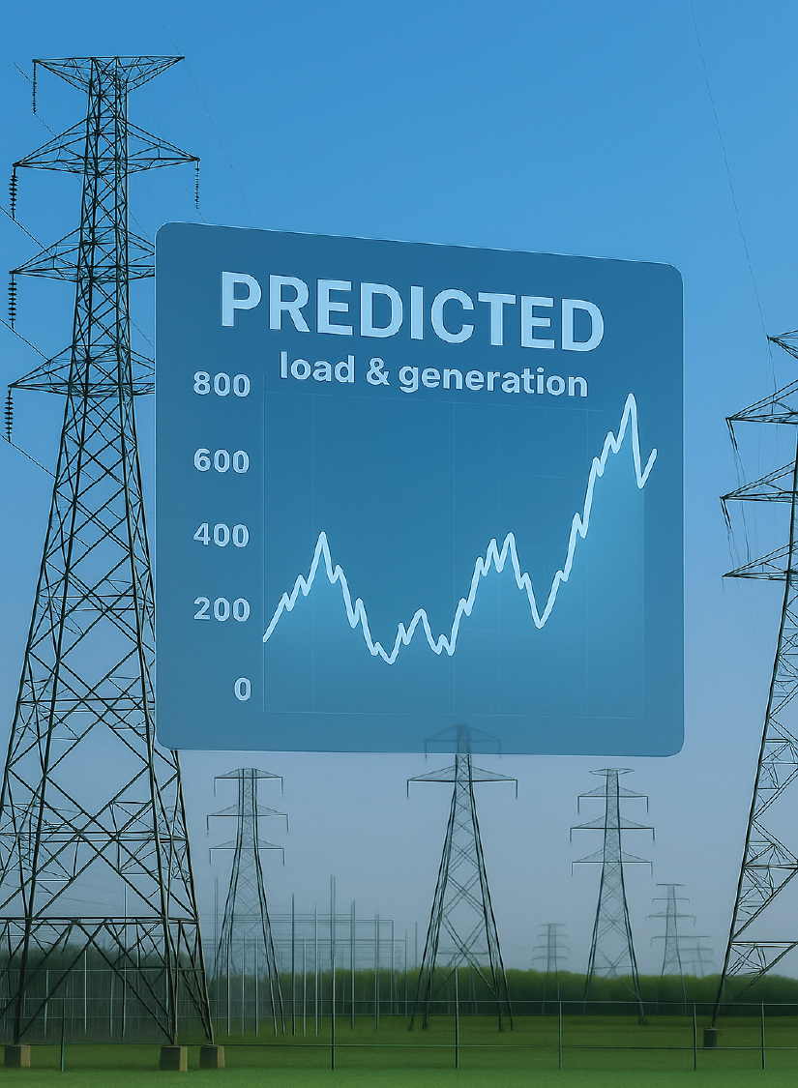
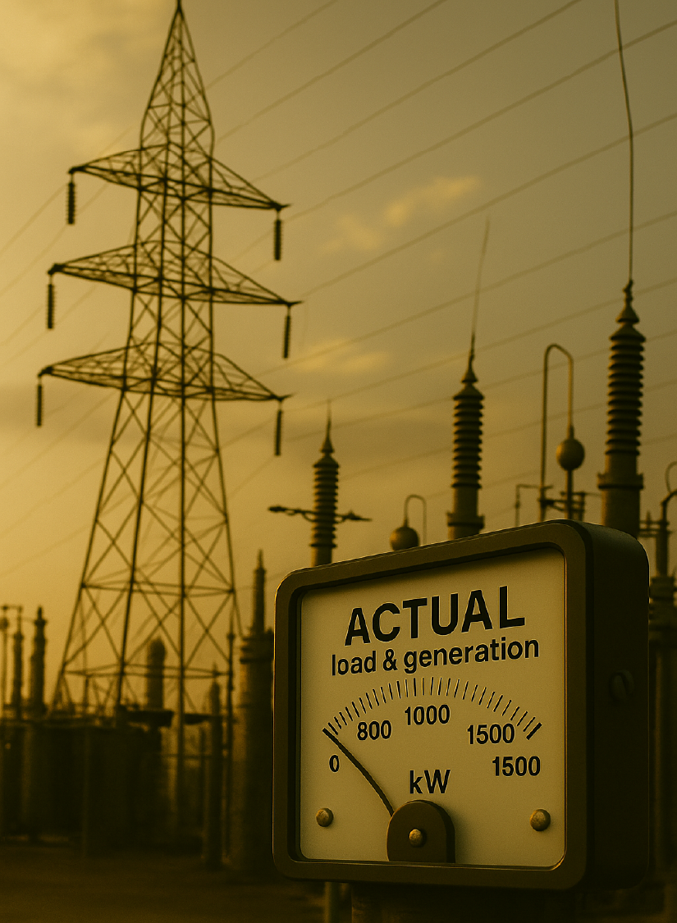
Predicted / Actual Load & Generation
Predicted Load & Generation Cards
Represent how energy planners forecast energy demand and generation
Accurate forecasting is essential not only to save money, but also for managing power plant generation.
Forecasts are based on several factors
  Historical data, weather forecasts, holidays, large customer demands, mathematical models, and more.
Actual Load & Generation Cards
Represent what really happens day-to-day, even after all that planning.
The best forecasts can still be wrong, due to unexpected factors like sudden weather changes or spikes in energy consumption
Operators must quickly adapt to ensure all customers continue to receive the energy they need.
Notes:
Predicted cards represent how energy planners forecast the next day’s energy demand and generation.
- Critical especially for renewable sources, whose generation output is dependent on natural events such as weather and geography.
Accurate forecasting is essential underpredicting can lead to expensive last-minute energy purchases, while overpredicting results in wasted energy and money.
Planners rely on historical data, weather forecasts, special events (like holidays), large customer demands, and mathematical models to make informed estimates.
The actual cards represent real-world scenarios that can occur even after highly accurate predictions.
They highlight that even the best forecasts can still be wrong due to unexpected factors like sudden weather changes (e.g., thunderstorms or severe conditions) or spikes in energy consumption.
When reality doesn’t match the prediction, grid operators must quickly adapt to ensure all customers continue to receive the energy they need.

Slide 11
Energy Grids & Strategic Planning
The electrical grid is carefully planned to maximize function, efficiency, and accessibility.
Thoughtful design ensures the grid can reliably serve energy loads and meet demand.
Strategic placement of power plants to maximize generation for areas they serve.
Developing resilient infrastructure to reduce impacts from damages and outages.
Planning to adapt to new technologies, new policies, and changes in the market, to maintain cost effectiveness, reliability, and stability.

Slide 12
Resilient Infrastructure is Essential
Electric grids need to be ready to adapt “to meet growing challenges and threats such as extreme weather and cyberattacks, to load growth and aging infrastructure” [2]
“A resilient power grid withstands, responds to, and recovers rapidly from major power disruptions” [3]
Resilience refers to “the ability to ‘absorb’ an event”, as well as “how quickly power can be restored after an outage.”[3]
Interconnections in the electrical grid network helps maintain reliability. This redundancy helps prevent failures from causing interruptions in service. [1]
Notes:
Resiliency = redundancy
Having multiple routes for power to reach the same destination, help when there is outages due to disruptions in the grid such as storms, repairs, etc.

Slide 13
Balancing Supply and Demand
Generation = Load
The electrical grid must balance the supply and demand of energy.
Cost Effectiveness
Backup storage like batteries helps store excess energy for later use.
Plan for the Unexpected
Flexible fuel sources (i.e natural gas) can quickly increase or decrease power output based on demand.
Ready to Adapt
Constant adjustments are made to prevent power overloads or shortages.

Slide 14
Roles Reflect Real Careers in Energy
Game Role → corresponding real-world career
Chief Operations Officer → Grid Operations Manager
Load Legend → Energy Analysist or Power Systems Analyst
Volt Architect → Power Systems Engineer or Developer
Line Specialist → Line-worker/Lineman
Dispatch Officer → System / Grid Dispatcher
Energy Resource Manager → Integrated Resource Planner
Notes:
Chief Operations Officer & Grid Operations Manager = oversee large parts of grid management
Load Legend & Energy Analysist of Power Systems Analyst = use data and models to predict when and where electricity will be needed
Volt Architect & Power Systems Engineers or Developers = plan, design, and oversee construction of power generation facilities, and other related infrastructure
Line Specialist & Line-Workers/Linemen = on the ground workers, building and fixing power lines and other critical infrastructure
Dispatch Officer & System/Grid Dispatcher = react to outages, directing repair crews, and ensuring safety and efficiency
Energy Resource Manager & Integrated Resource Planner = Make long-term decisions about energy sources, manage fuel, as well as cost efficiency, and sustainability of the grid.

Slide 15

Resources/Reference:
Grid Status
real time energy usage & prices
Electrical Load – Energy Education [1]
Electric Grids – U.S. Department of Energy [2]
Power System Resilience – National Renewable Energy Laboratory [3]
How Power Grids Work – HowStuffWorks
Energy4me – Essential Energy Education
Energy 101: Electricity Generation – Energy Now News
Energy Explained – U.S. Energy Information Administration (EIA)
Notes:
Electrical load. (2018, May 11). Energy Education. Retrieved 16:09, August 1, 2025 from https://energyeducation.ca/wiki/index.php?title=Electrical_load&oldid=6089.
Electric Grids. (2024, July 8). Energy.gov. https://www.energy.gov/topics/electric-grids
Power System Resilience | NREL. (2024). Nrel.gov. https://www.nrel.gov/research/power-system-resilience

Slide 16
Teacher Resources

Slide 17
Learning Objectives
Students will be able to explain in simple terms why generation needs to match load.
Students will be able to compare different generation methods & explain the strengths & weaknesses of these methods.
Students will be able to describe how events in one area of the electrical grid affect other areas.
Students will be able to list sources of distribution & transmission instability & vulnerability.
Students will be able to demonstrate how a diverse mix of generation resources as well as redundant connections help mitigate and prevent outages.
Students will be able to identify different energy storage methods and explain why these energy storage methods would be used in the power grid.

